Slide 1
Aligning the Gas and Electric Markets: EDF Solutions
November 30, 2016

Slide 2
Overarching Goals
Improve economic and operational coordination between the gas and electric industries
Natural gas markets need tools and services to dynamically respond to the reliability needs of gas-fired generators
Products and services in each market should generate effective price signals in and across the two markets so that appropriate right-sized investments are made

Slide 3
Overarching Goals
Continue market refinements that promote allocative efficiency.
Foster economic incentives and competition to capture the value of services
Price formation for, and investment in, deliverability (incl. sub-day variability)

Slide 4
Current Misalignment
Several RTOs effectively require generators to use flat daily gas index pricing for fuel, even though electric prices are hourly. Although some hourly variation is possible with documentation, market monitors often mitigate to flat daily gas index.
Pipelines are paid for point-to-point throughput capacity, not deliveries.
Example: Access Northeast’s proposed take and replace service (facilitated by LNG) is largely unpriced.
The service of matching hourly fuel to hourly generation is currently unpriced.

Slide 5
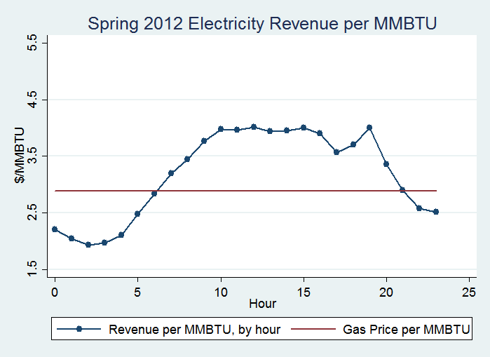
Spring Hourly Patterns for Electric Revenue per MMBTU versus Daily Algonquin Citygate Price
Negative Margin
Positive Margin
Generators are often mitigated based on a flat daily gas index price, but gas use and value varies hourly depending on generator demand.

Slide 6
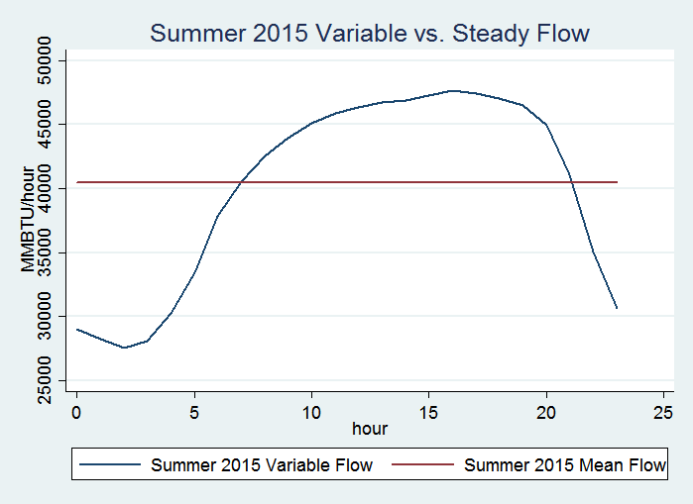
Summer Variable vs. Ratable Flow
The flat line represents uniform hourly (i.e., ratable) flow for the average day, and the shaped line shows what the flows had to be to generate the electrical output.

Slide 7
Summer Hourly Patterns for Gas Costs and Electricity Revenue
Generators’ hourly gas spend correlates to output. In general, the market provides sufficient margin to facilitate price formation for the value of peak and sub-day (non-ratable) services.

Slide 8
Margin between Daily Gas Costs and Hourly Electric Revenue by Season
Season | Electricity Revenue | Total Gas Spend | Margin/Rent
Winter 2012 | $221,000,000 | $212,000,000 | $10,000,000
Spring 2012 | $227,000,000 | $182,000,000 | $44,000,000
Summer 2012 | $405,000,000 | $318,000,000 | $88,000,000
Fall 2012 | $319,000,000 | $322,000,000 | ($3,000,000)
Winter 2013 | $490,000,000 | $535,000,000 | ($46,000,000)
Spring 2013 | $316,000,000 | $299,000,000 | $17,000,000
Summer 2013 | $423,000,000 | $324,000,000 | $99,000,000
Fall 2013 | $329,000,000 | $355,000,000 | ($26,000,000)
Winter 2014 | $639,000,000 | $705,000,000 | ($67,000,000)
Spring 2014 | $307,000,000 | $277,000,000 | $30,000,000
Summer 2014 | $337,000,000 | $246,000,000 | $91,000,000
Fall 2014 | $279,000,000 | $268,000,000 | $11,000,000
Winter 2015 | $524,000,000 | $552,000,000 | ($28,000,000)
Spring 2015 | $208,000,000 | $157,000,000 | $51,000,000
Summer 2015 | $308,000,000 | $210,000,000 | $98,000,000
Fall 2015 | $230,000,000 | $193,000,000 | $37,000,000
SUM | $5,562,000,000 | $5,156,000,000 | $406,000,000

Slide 9
Conclusions
Generators are not able to buy variable sub-day services and are restricted to what they can bid based on daily index pricing for natural gas supply.
Out-of-market procurement solutions are not working – need to correct misalignment by pricing and reflecting the value of variable deliverability (i.e., hourly shaped flows)
Shaped flows would allow generators to schedule varying flow quantities of gas for delivery the next day that correlate to their anticipated output levels.
With updated scheduling and pricing regimes, sub-day flexibility on the gas side can be efficiently priced providing benefit to pipelines, generators, flexibility service providers and consumer savings.
Price formation increases innovation, product definition and spurs investment.

Slide 10
EDF Solutions – NAESB
Order No. 809 directed NAESB to explore new options and standards for faster and more flexible pipeline scheduling.
EDF proposed standards for provision of “mutual agreement” scheduling for natural gas pipeline transportation that is:
a) scheduled outside of the standard grid-wide nomination cycles,
b) permits flow changes outside of standard schedule flow periods; and/or
c) involves Shaped Flow Transactions (allow generators to schedule varying flow quantities of gas for delivery the next day that correlate to their anticipated output levels).

Slide 11
EDF Solutions – Pilot Program
Three-year voluntary pilot program
Continue gas-electric coordination enhancements
Delineate and price new services for scheduling non-ratable flows

Slide 12
EDF Solutions – Pilot Program
Benefits of Program
Shaped flows will allow generators to schedule varying flow quantities of gas that correlate to their anticipated output levels
Variability is crucial, as gas generators increasingly become providers of flexible services to balance renewable integration
New revenue streams for pipelines will help shift current market design to reward pipelines for flexible capacity
Pricing receipt and delivery of flexible services will help create the right market signals for investment that is most efficient

Slide 13
Appendix: Methodology and Data
Data:
EPA Air Markets Program Data (AMPD)
NE-ISO aggregated real-time hourly electricity prices (internal hub)
SNL Daily Algonquin Citygate Price (Day ahead)
Scope:
Gas generators in AMPD
located in MA, CT and RI
‘pipeline gas’ as primary fuel
Seasons (selected by months with most similar patterns):
Winter: January – March
Spring: April – June
Summer: July – September
Fall: October – December
Electricity revenue per MMBTU of gas: weighted seasonal average for the hourly electricity price times the hourly average conversion efficiency for all plants ($/MWH*MWH/MMBTU)

Slide 14
The following four slides depict: 1. Average Algonquin Citygate daily gas prices for each of the graphed time periods (Springs 2012–2015, Summers 2012–2015, Falls 2012–2015 and Winters 2012-2015) 2. Average hourly electric prices by hour for all hours of each day across the same periods 3. The positive or negative hourly value of the difference between cost of delivered gas and value of delivered gas (i.e., electric revenue per MWH converted to commensurate value of gas)

Slide 15
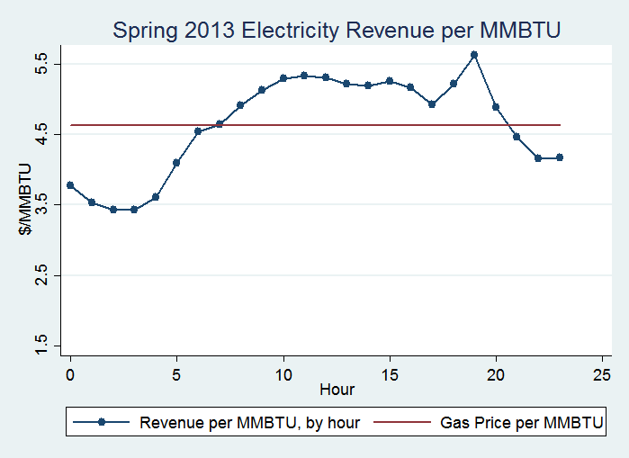
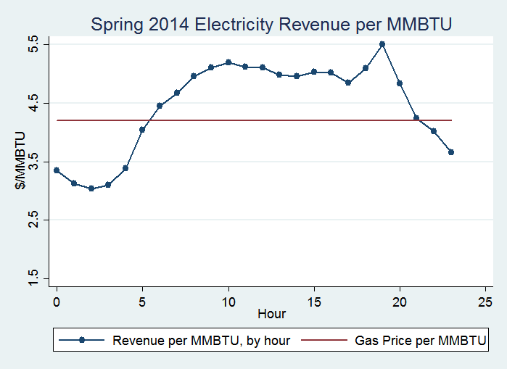
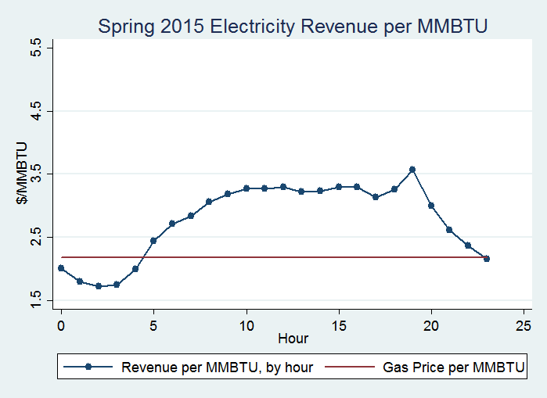
Spring Hourly Patterns for Electric Revenue per MMBTU versus Daily Algonquin Citygate Price
Negative Margin
Positive Margin

Slide 16
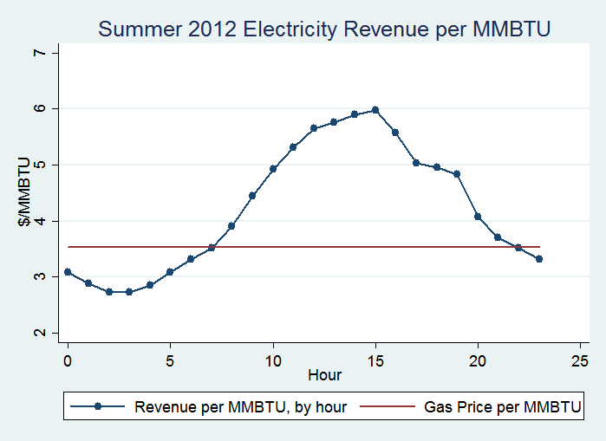
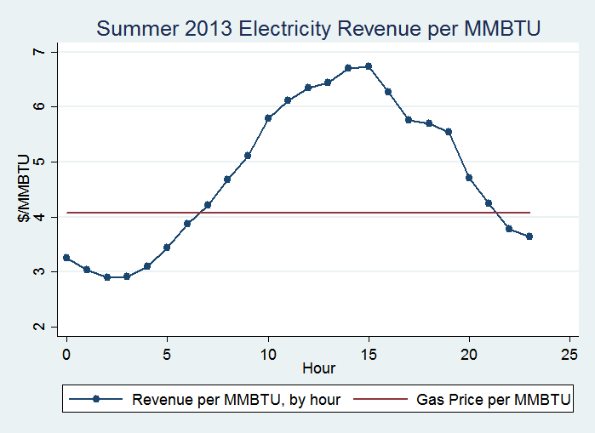
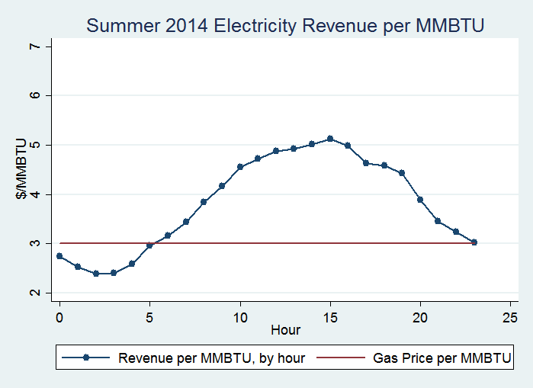
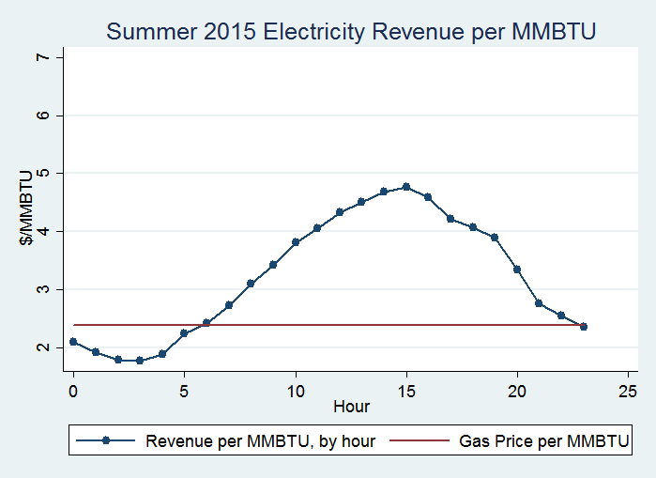
Summer Hourly Patterns for Electric Revenue/MMBTU versus Daily Algonquin Citygate Price

Slide 17
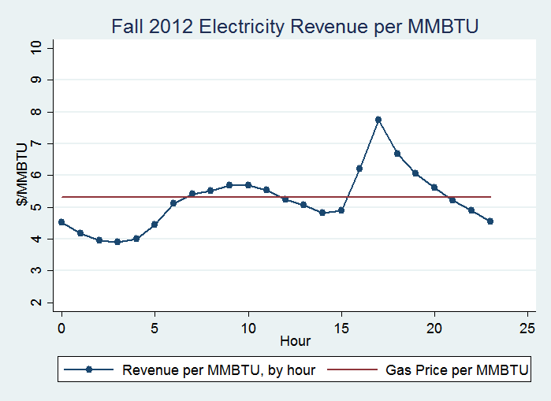
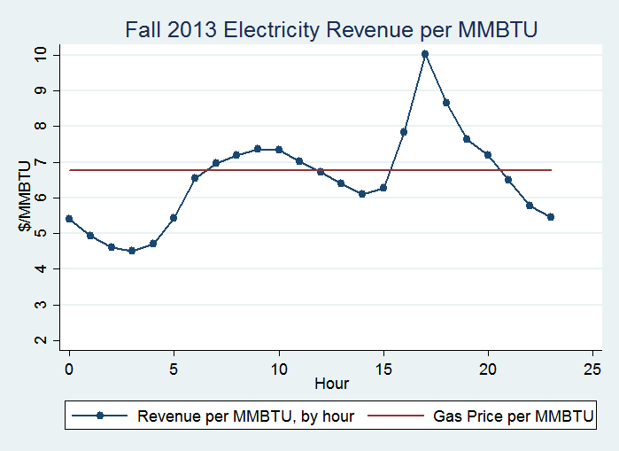
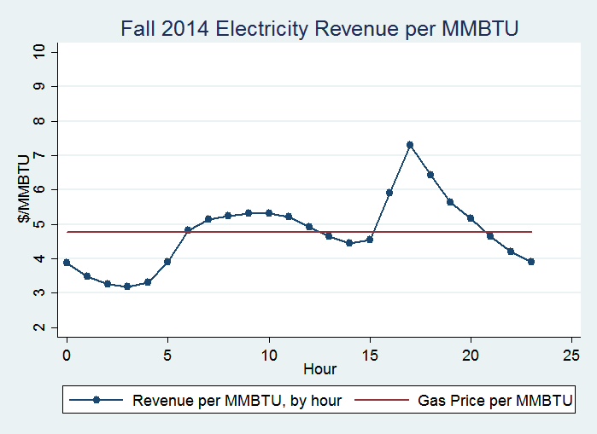
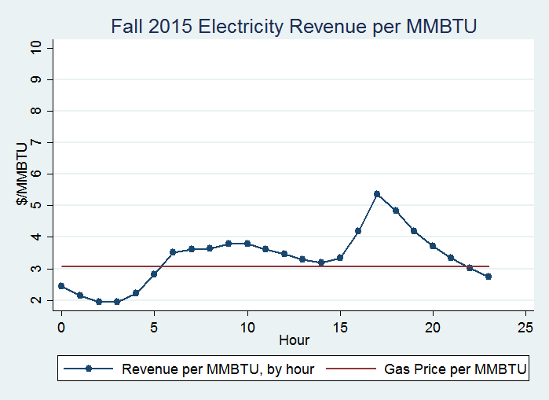
Fall Hourly Patterns for Electric Revenue/MMBTU versus Daily Algonquin Citygate Price

Slide 18
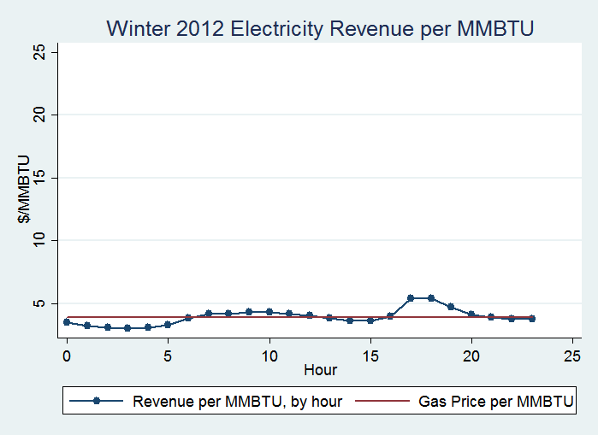
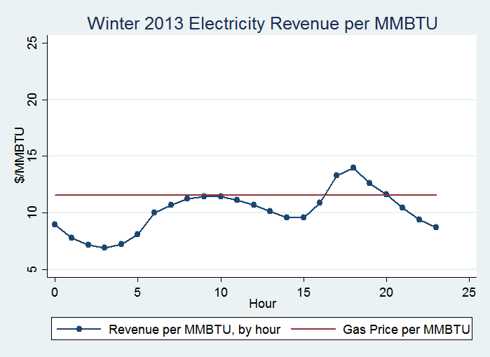
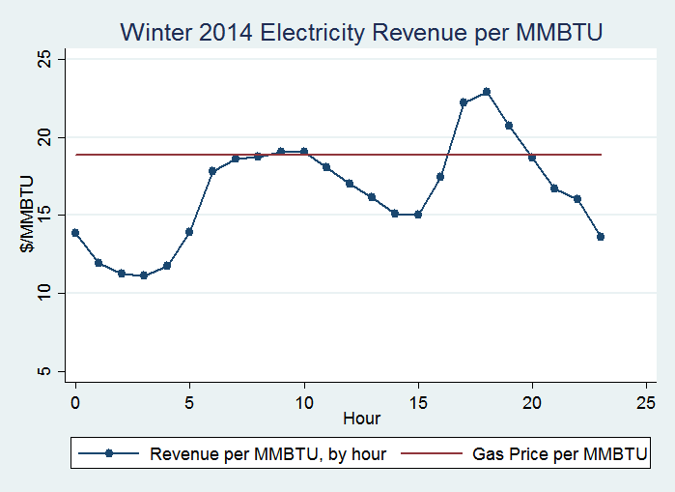
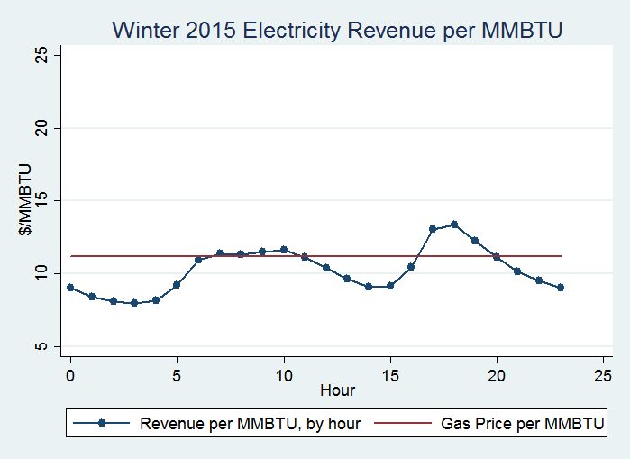
Winter Hourly Patterns for Electric Revenue/MMBTU versus Daily Algonquin Citygate Price

Slide 19
The following four slides show four representative months’ daily gas prices versus daily average electric revenue converted to the underlying value of the delivered gas that generated the electricity.

Slide 20
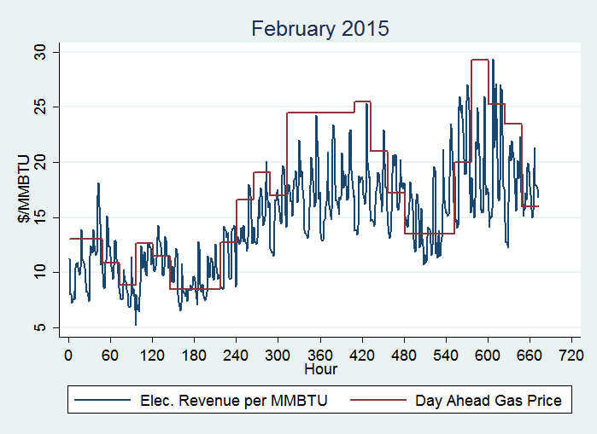
February 2015 Electric Revenue vs Gas Price

Slide 21
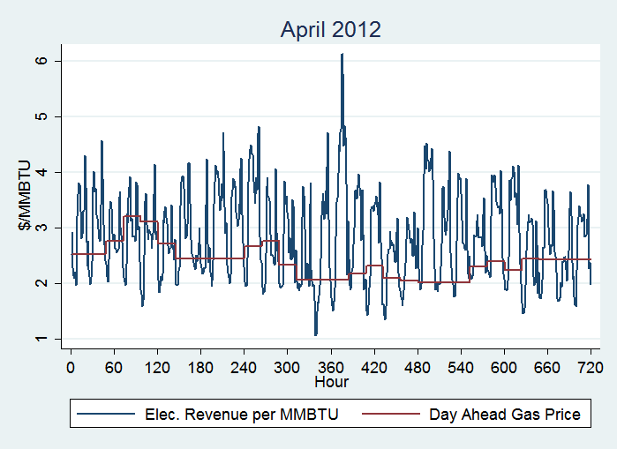
April 2012 Electric Revenue vs Gas Price

Slide 22
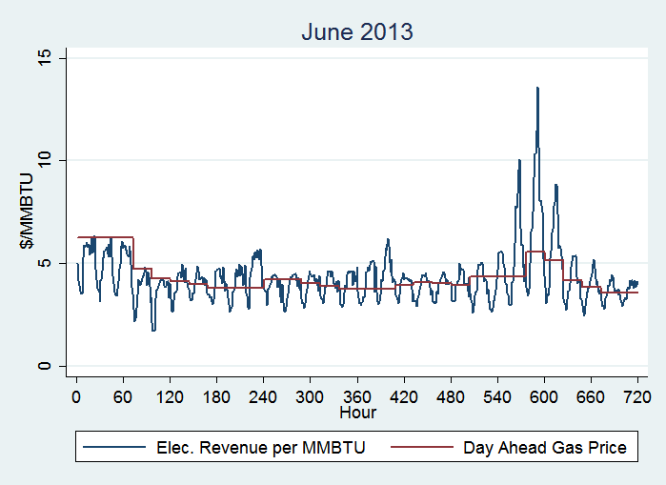
June 2013 Electric Revenue vs Gas Price

Slide 23
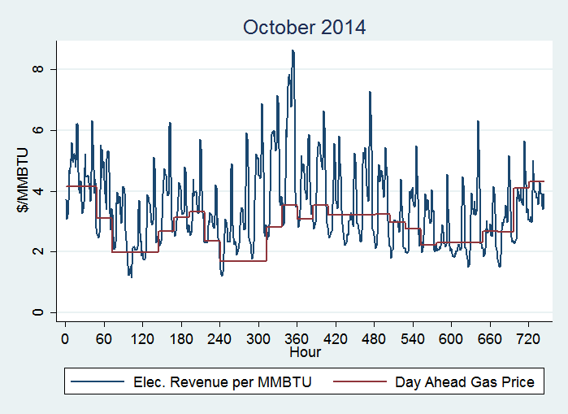
October 2014 Electric Revenue vs Gas Price

Slide 24
The following four slides show for each of the seasons over the four year 2012-2015 period, the average hourly variance in gas deliveries by the pipeline that were required to match the hourly output by the pipeline-connected electric generators. The flat line represents uniform hourly (i.e., ratable) flow for the average day, and the shaped line shows what the flows had to be to generate the electrical output.

Slide 25
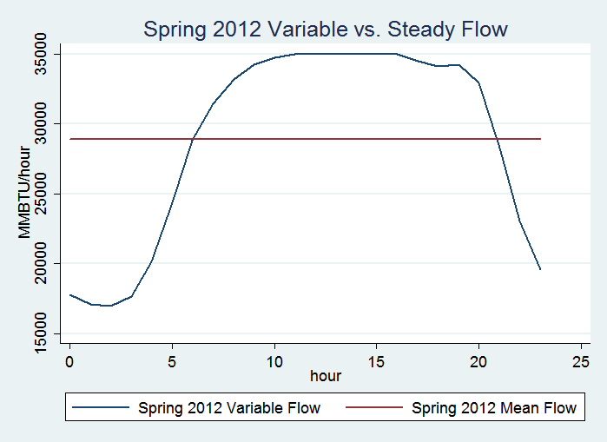
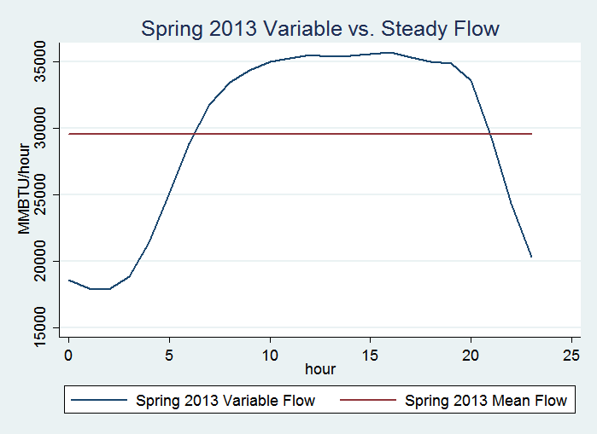
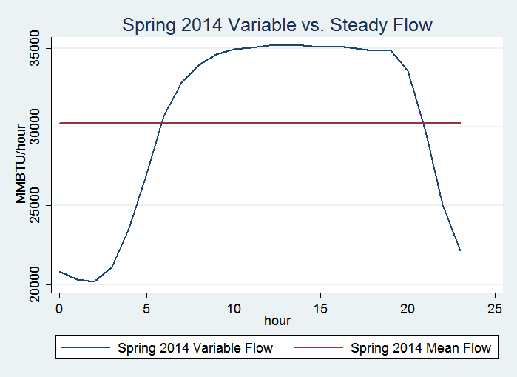
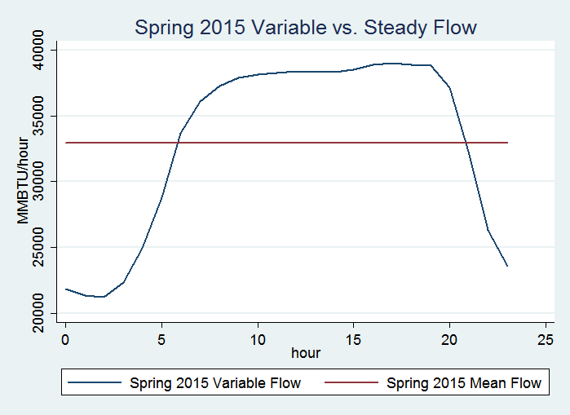
Spring Variable vs. Ratable Flow

Slide 26
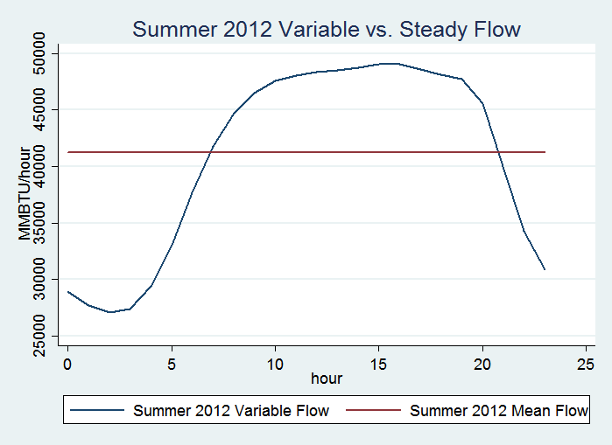
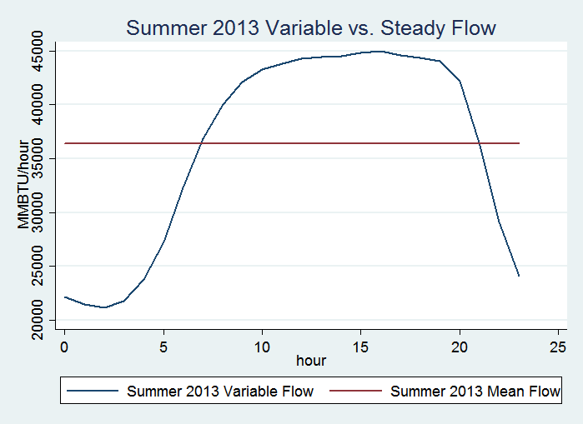
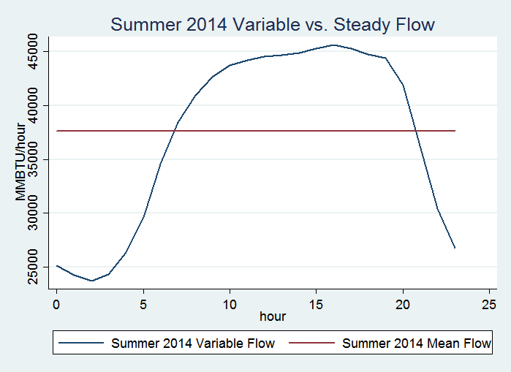
Summer Variable vs. Ratable Flow

Slide 27
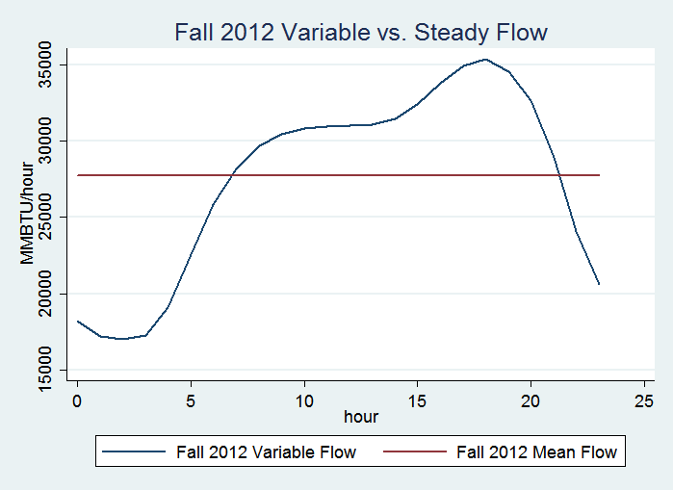
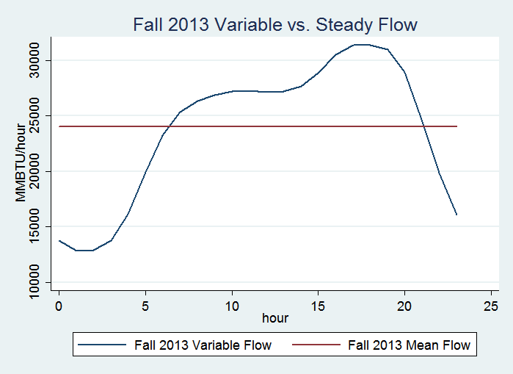
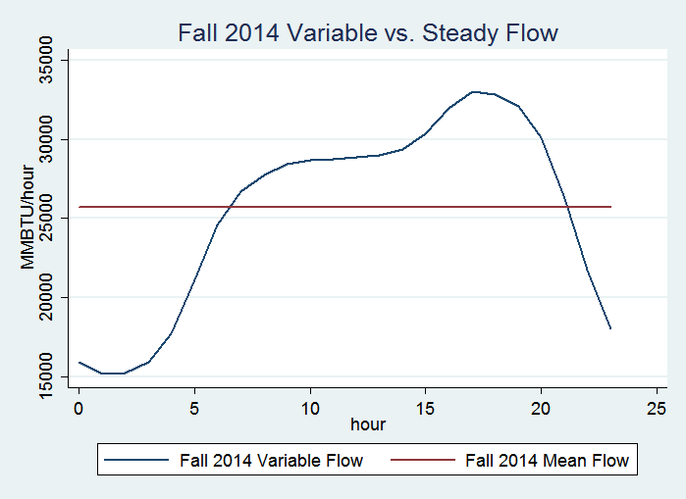
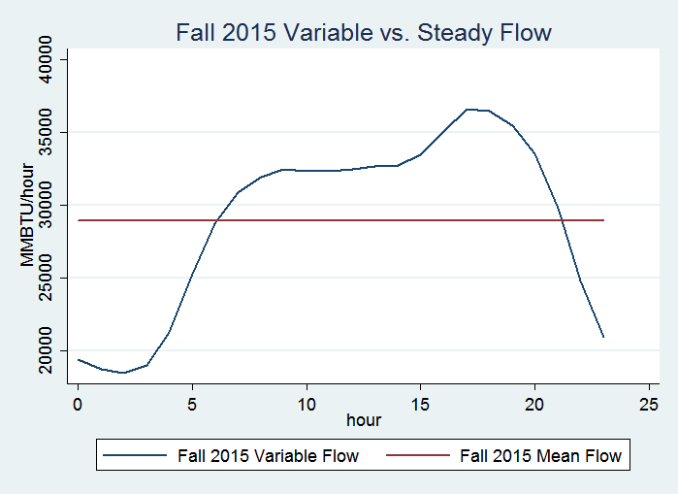
Fall Variable vs. Ratable Flow

Slide 28
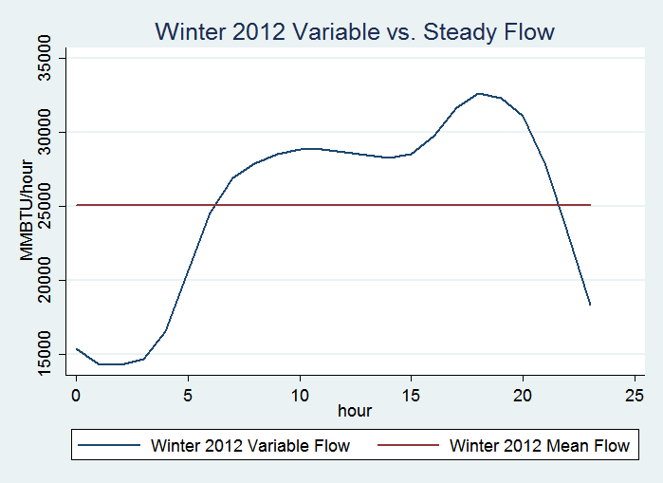
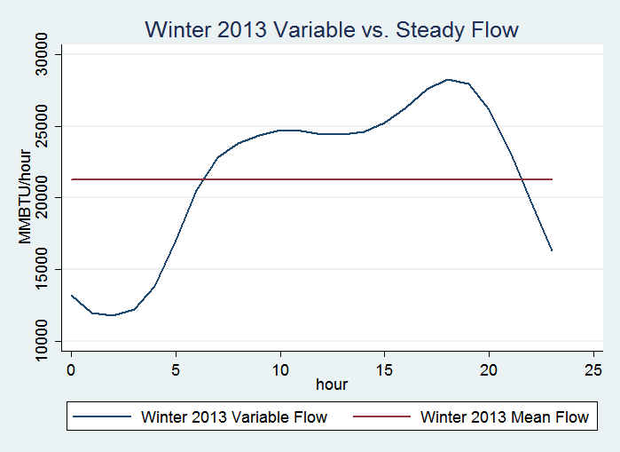
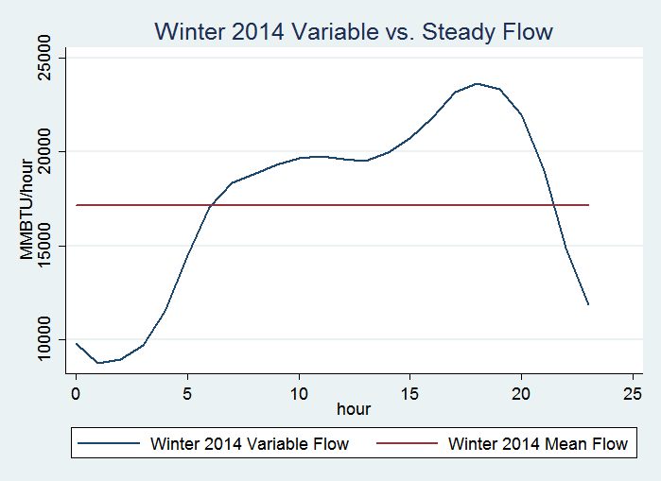
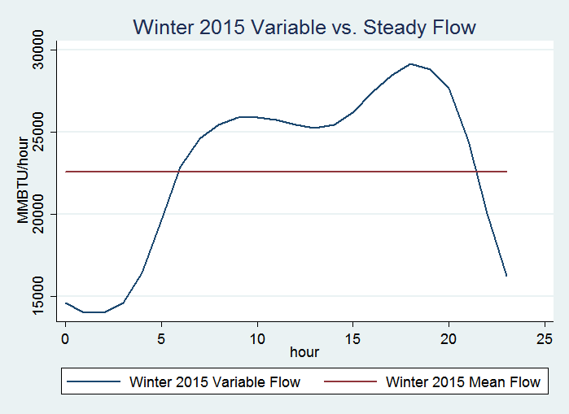
Winter Variable vs. Ratable Flow

Slide 29
The following four slides show, by season, across the 2012-2015 period those hours of each day, where, on average, there is value available to be captured by matching variable pipeline flow to variable electric generator output. Electric prices are hourly – but gas commodity and gas transportation prices are at best daily. Moreover, the service of matching hourly fuel to hourly generation is currently unpriced.

Slide 30
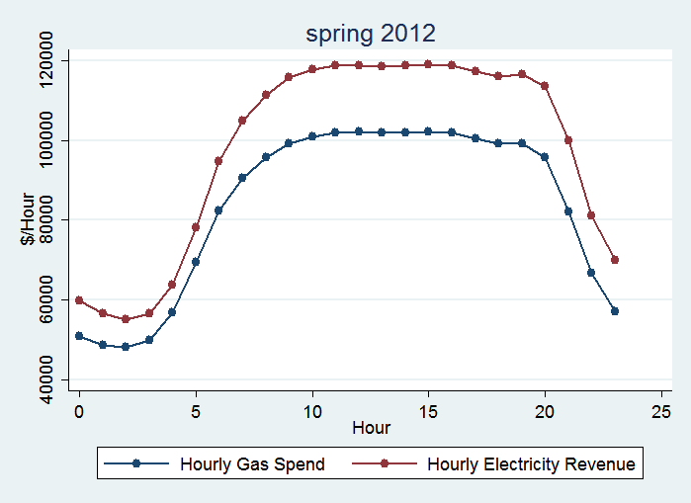
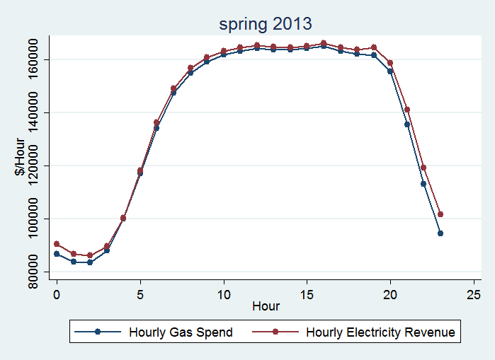
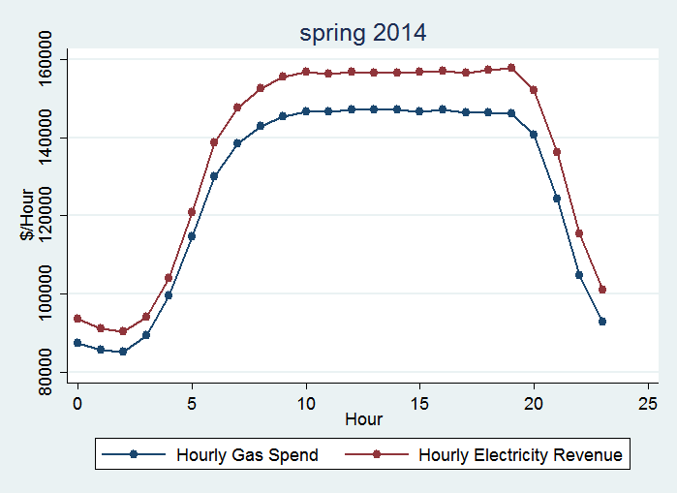
Spring Hourly Patterns for Gas Costs and Electricity Revenue

Slide 31
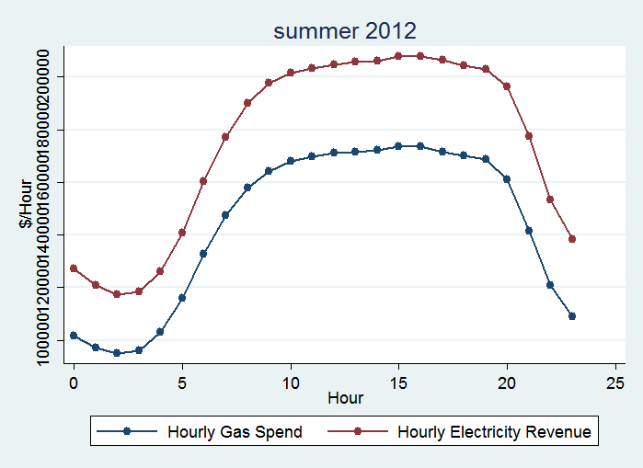
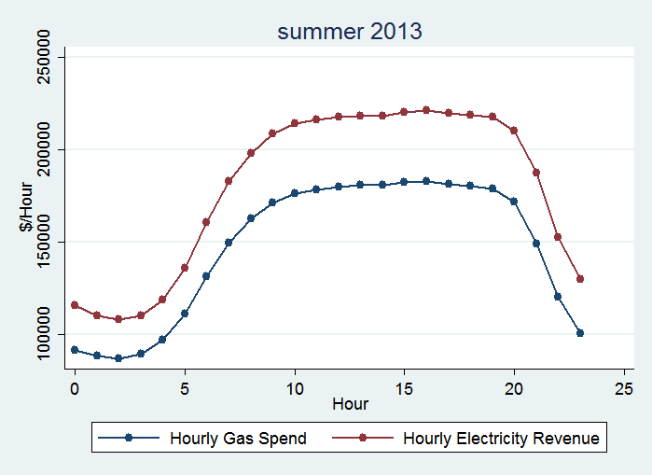
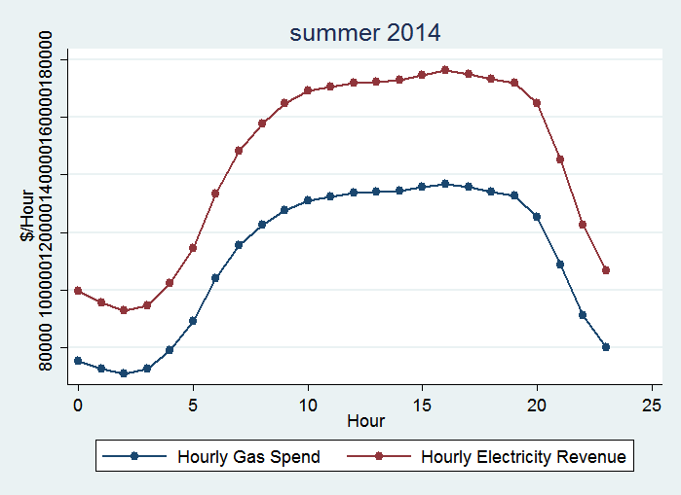
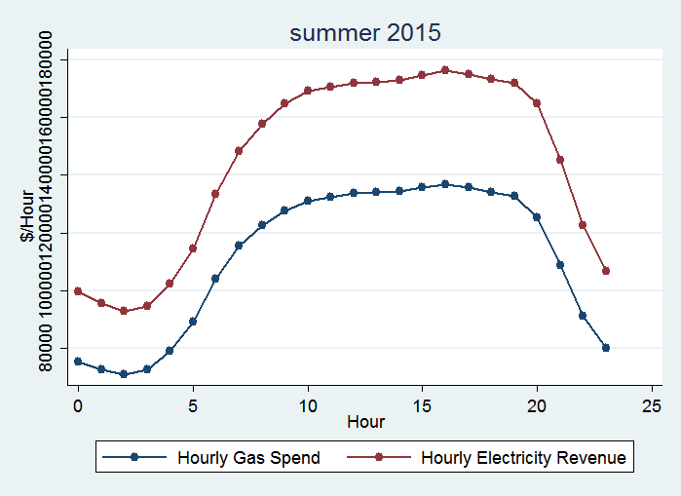
Summer Hourly Patterns for Gas Costs and Electricity Revenue

Slide 32
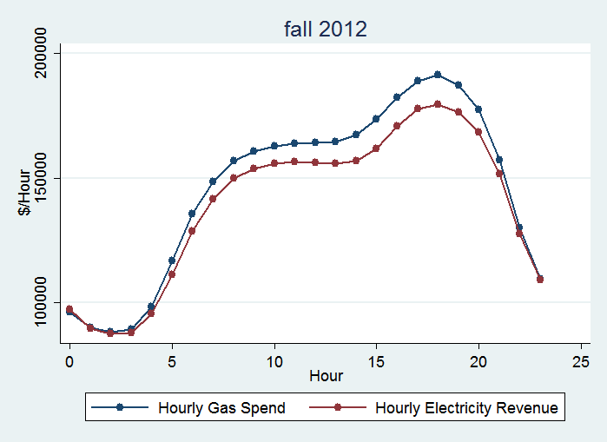
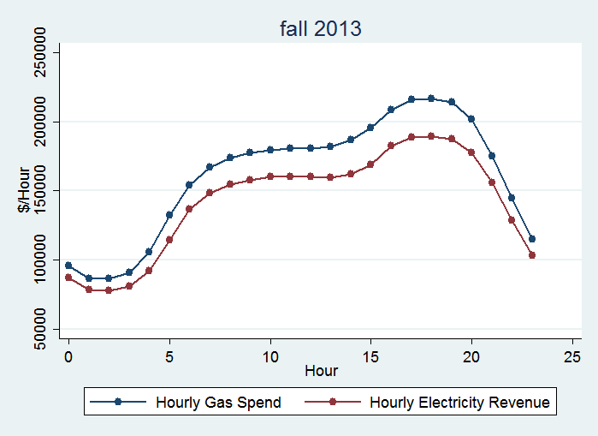
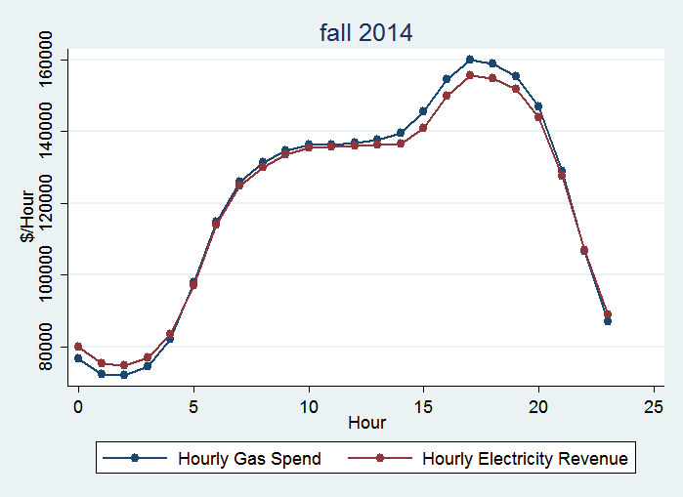
Fall Hourly Patterns for Gas Costs and Electricity Revenue

Slide 33
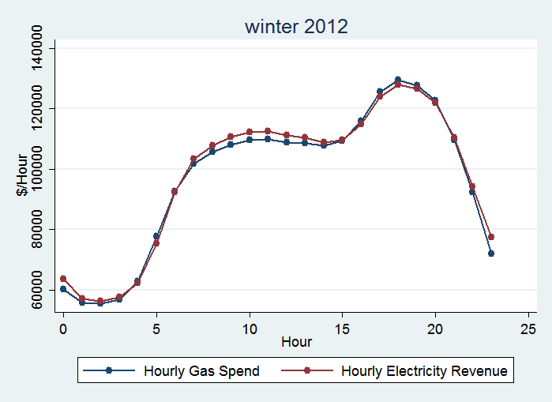
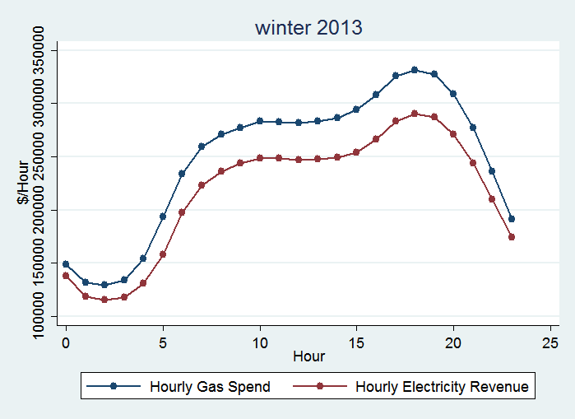
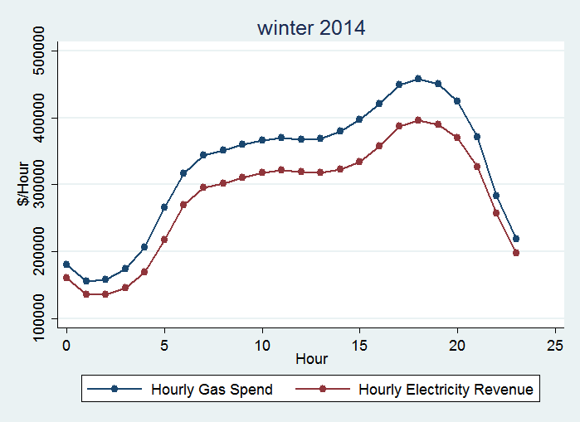
Winter Hourly Patterns for Gas Costs and Electricity Revenue

Slide 34
Background Material: Graphs on Real-time Electricity Price

Slide 35
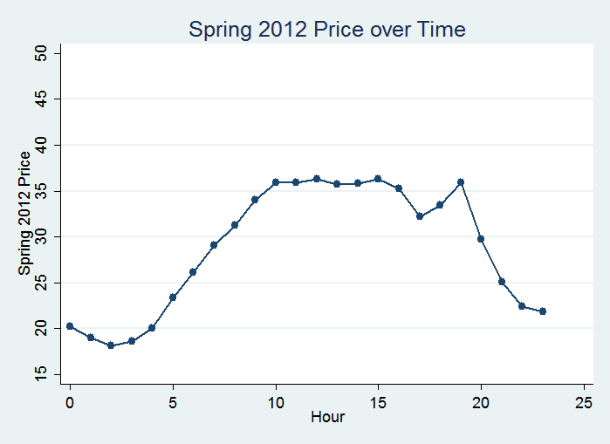
Spring Real-Time Electricity Price

Slide 36
Summer Real-Time Electricity Price

Slide 37
Fall Real-Time Electricity Price

Slide 38
Winter Real-Time Electricity Price

