Slide 1
DOE Operational Coordination
Standard Distribution Services Contract
Joe Paladino
Office of Electricity
US Department of Energy
Saumil Patel
ICF
Paul De Martini
Newport Consulting Group
North American Energy Standards Board February 7, 2024

Slide 2
An Observation
“Currently, individual states, such as California and New York, are developing their own distribution-level solutions to DER integration. While these efforts are reflective of the actions of individual, forward-looking states, this approach is insufficient, as each state has to essentially reinvent the wheel. This situation will lead to a proliferation of disparate standards, terminology and approaches around DER integration across the United States, which in turn will generate confusion and increase costs among manufacturers, developers, and other DER service providers. It will ultimately result in less access to distribution systems for DER providers, higher DER costs, and lower benefits to customers.”
Excerpt from The Transition to a High-DER Electricity System – Creating a National Initiative on DER Integration for the United States, Energy Systems Integration Group (ESIG), August 2022; The Transition to a High-DER Electricity System: Creating a National Initiative on DER Integration for the United States - ESIG

Slide 3
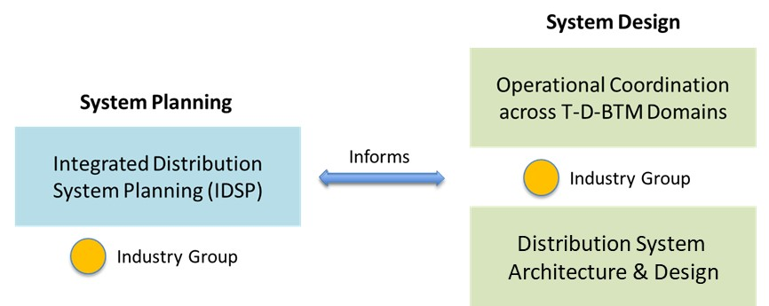
Distribution Grid Transformation Program Strategy
We need to address institutional, business and technological issues to formulate rational and forward-looking investment strategies
Advancing best practices for formulating grid investment strategies that serve communities, states, and their affected publics
Staged strategies for advancing grid structure and function to meet current drivers and uncertainties
Partners:
Internal – Joint OE/EERE (e.g., Grid Solutions Program) for DER integration and GDO for resilience planning
External – NARUC, NASEO, NGA, NCSL, NRECA, APPA, RAP, ESIG, EPRI, IEEE, EEI, AEIC

Slide 4
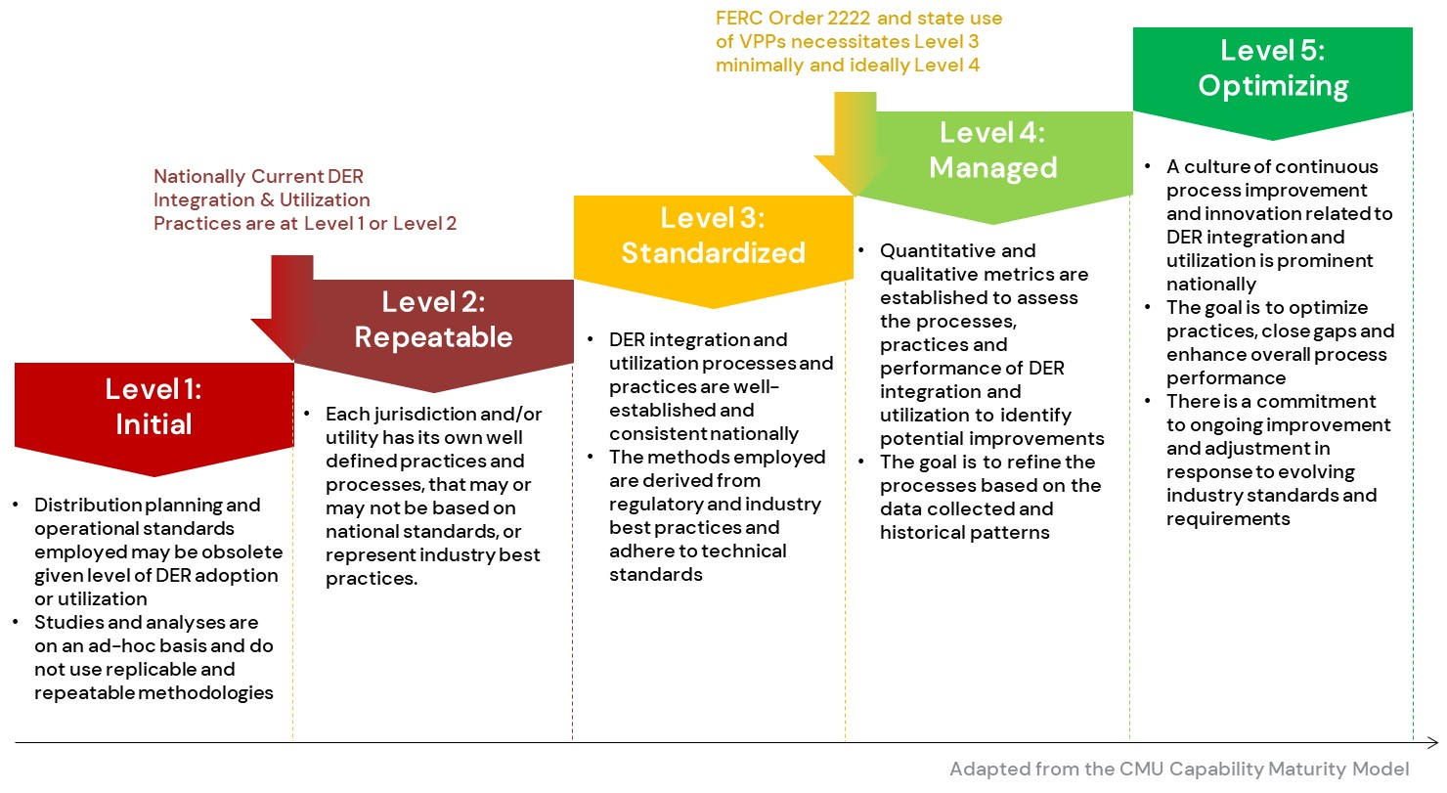
Transmission-Distribution-Customer Operational Coordination
Customer, business, and institutional adoption and expanded utilization of distributed energy resources (DERs) and electrification is expanding the need for maturing regulation and practices by which all participants involved can coordinate reliably and efficiently.
In this area, DOE is examining regulatory, business, and technical practices and standards (“distribution grid codes”) needed to support the effective coordination of these grid-edge resources with distribution planning and operations. This involves defining “what” is needed, considering “how” best practices should be implemented, and understanding “who” is responsible and the relative maturity needed.
Grid Codes Maturity Model

Slide 5
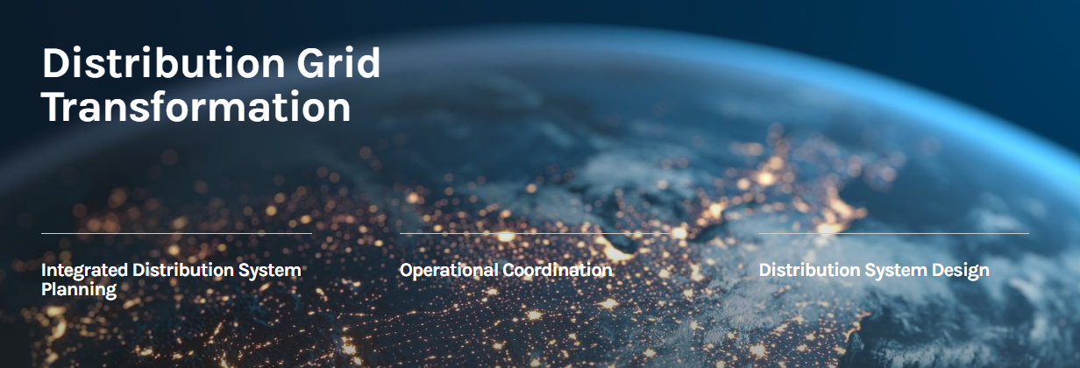
DOE’s Distribution Grid Transformation Program
The U.S. Department of Energy works closely with the electricity industry to identify challenges and proactively address grid transformation issues. Policies, changing customer preferences, and innovative technologies are all transforming power system planning and operations, particularly at the distribution grid.
This framework helps decisionmakers to develop holistic grid investment strategies that address community and state policies and increasing complexity at the grid edge.
The integration and utilization of distributed energy resources owned by multiple entities requires standard processes for coordinating grid operations.
Determining future distribution system designs will require a holistic understanding of needed functional and structural requirements.
https://www.energy.gov/distribution-grid

Slide 6
Standard Distribution Services Contract (DSC)

Slide 7
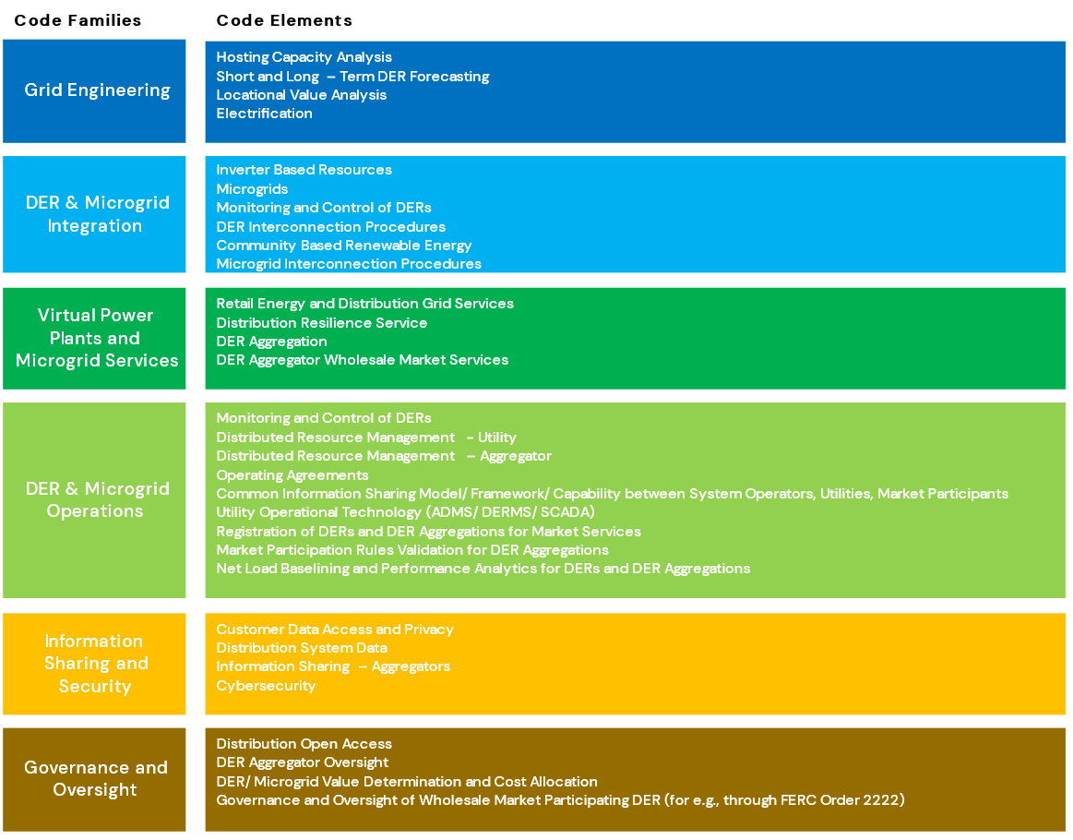
Distribution Grid Codes Context for DSC
Institutional
Business
Technical
Grid codes refer to the collection of institutional and business processes, and technical standards to safely and effectively integrate and utilize distributed energy resources and aggregations within the electric distribution system.
Why is the adoption of standardized grid codes required?
Customer affordability and clean energy policy objectives.
Uniform processes and techniques to enable the adoption & use of DERs at scale.
Notes:
The federal government has a goal of 100% clean electricity by 2035, and a target of net-zero emissions by 2050.
Recent publications, such as the DOE Virtual Power Plant (VPP) Liftoff report, project an incremental 60 GW of growth in US-wide peak demand between 2023 and 2030 (from 740 GW to 800 GW). VPPs have been identified as having the potential to meet 80-160 GW of peak demand by 2030.
If DER and VPP integration on the scale envisioned is to occur, standardized processes for DER deployment and grid planning will be required to create efficiencies and remove barriers to DER interconnection. If utilities were to create DER integration frameworks independently, it might result in suboptimal outcomes and inefficiencies.
Standardization of coordination mechanisms, system requirements and process repeatability is crucial to facilitating the integration and utilization of DERs and VPP services.
The goal of DOE’s Grid Code Framework is to create a unified framework to build a shared understanding and illustrative pathways for power system actors to prepare distribution systems for high penetrations of DER, thus meeting clean energy and climate objectives.

Slide 8

Standard Distribution Services Contract
A key challenge to achieving the desired scale of DERA-provided services [160 GW nationally] is that currently, distribution service contracts can vary by type of DER, by utility, and by state
A Distribution Services Contract between a DER Aggregator (Aggregator) and Distribution Utility addresses the provision of distribution services, including requirements that DER service providers must abide by to ensure the safe, reliable and economic functioning of distribution power system.
No standard service contracts nor codes of conduct exist today that specify discrete services and related performance expectations from independent Aggregators, including requirements for asset visibility, operational coordination, performance evaluation, and customer engagement.
Pathways to Commercial Liftoff: Virtual Power Plants
US DOE, September 2023

Slide 9
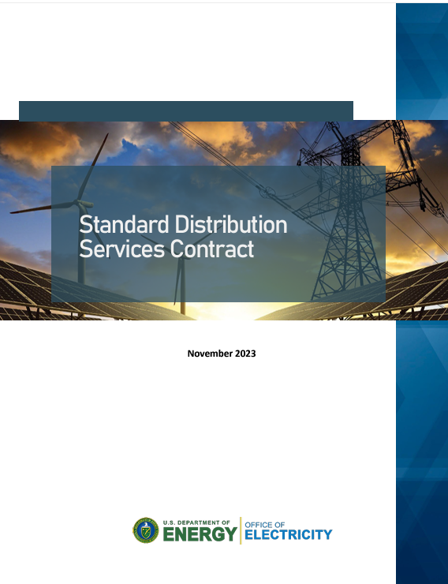
Standard Distribution Services Contract
The intent is to foster develop a standard contract between DER Aggregators and Distribution Operators applicable across the US to ensure a consistent and transparent contracting for distribution services.
Standard DSC paper provide a blueprint for a standardized pro-forma DSC contract that can provide sufficient consistency on key aspects, while allowing for some adaptation by regulators and utilities for their unique circumstances.
Paper focuses on the key contractual elements and related forms/agreements for provision of distribution grid services by aggregated DER.
  Addresses required market and operational coordination requirements stemming from FERC 2222 implementation.
  Does not address wholesale market tariffs/contracts, contracting between aggregators and customers, or contracts between utilities and DER program administrators.
This DSC framework is based on industry insights from aggregators, utility practitioners, and regulators, as well as new FERC 2222 coordination requirements.
https://energy.gov/sites/default/files/2023-11/2023-11-15%20Standard%20Distribution%20Services%20Contract_optimized.pdf

Slide 10
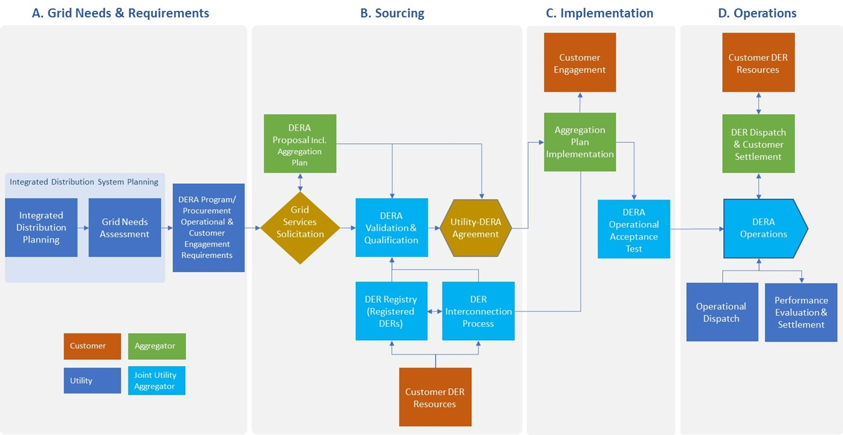
Distribution Grid Services Lifecycle
DSC focuses on implementation & operations, but reflects upstream requirements & information

Slide 11
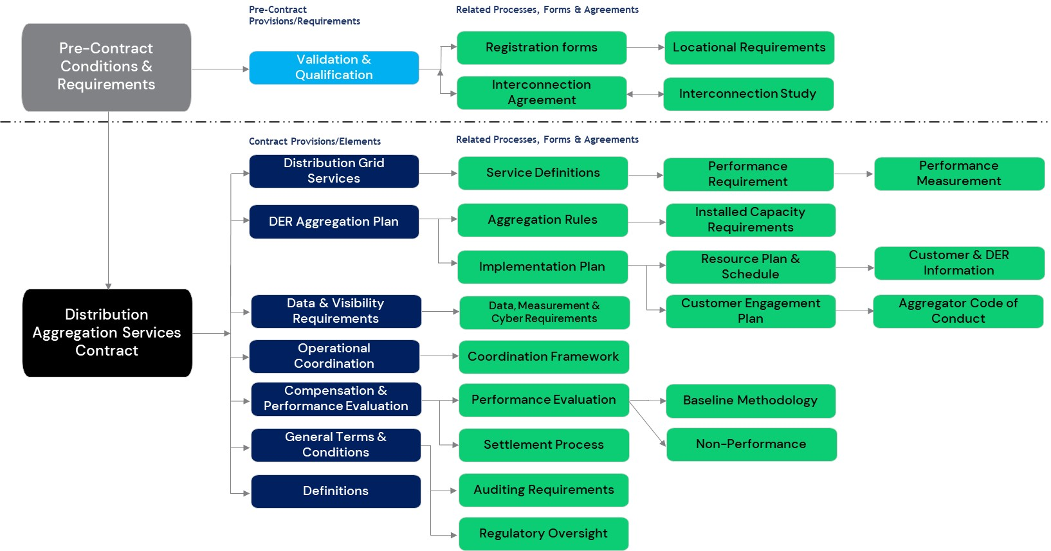
Distribution Services Contract Structure

Slide 12
Standard Distribution Services Contract Structure
Prior to contracting, there are several key aspects that inform a DSC

Slide 13
DSC Key Contract Provisions & Elements
This framework provides a standard pro-forma structure for a DER Aggregation services contract for distribution services between DER Service Providers and Distribution Utilities.
This framework provides a foundation to build a standard pro-forma services agreement to reduce market barriers and ensure consistent application of key provisions.
This DSC framework offers a common language and structure for defining and describing DER services including eligibility, functionalities, service quality measures, compensation framework, participation, and coordination models.

Slide 14
DSC Incorporates Related Rules, Processes, and Agreements
Framework identifies typical enabling rules, processes and documents for aggregation services required to ensure reliable performance
These associated rules, processes and documents link to specific contract provisions, and critical tasks owned by distribution utilities, DER Aggregators or both from initial DER service registration to the end of the DER service lifecycle.
It is recognized that many of these related aspects may be unique to each jurisdiction/utility, so a standard DSC will need to be structured to allow for some adaptation.

Slide 15
Distribution Services Contract - Additional Resources
https://energy.gov/sites/default/files/2023-11/2023-11-01%20Grid%20Services%20Definitions%20nov%202023_optimized_0.pdf
https://energy.gov/sites/default/files/2023-11/2023-11-01%20DER%20Aggregator%20Code%20of%20Conduct%20nov%202023_optmized.pdf

Slide 16

Thank You
Contact: Saumil Patel, ICF Saumil.Patel@icf.com

