Slide 1
Manual TEC Analysis
Sandip Sharma
ERCOT

Slide 2
Discussion point
ERCOT Frequency Profile
Manual Time Error Correction
Manual TECs from Jan -2011 to March-2012(March 30th)
Plot of Regulation during Manual TECs
Manual Time Error Correction Procedure
NERC BAL-004 Standard
NAESB Manual-Time Error Correction procedure
Next Steps

Slide 3
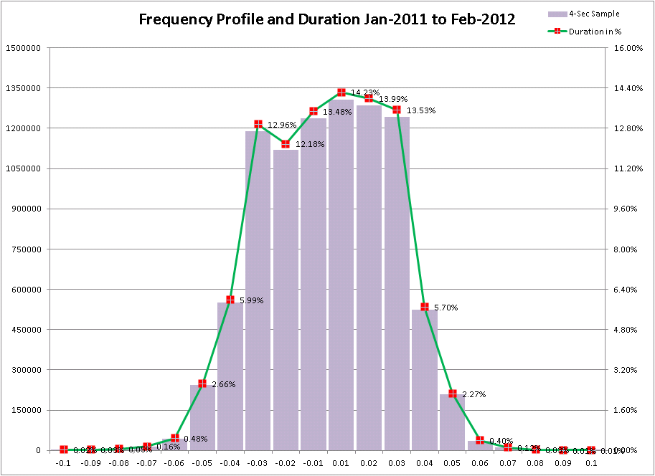

Slide 4
Frequency Profile – Table
Delta Frequency | 4-Sec Sample | Duration in % | Frequency above and Below 60 Hz
-0.15 | 250 | 0.00%
-0.14 | 463 | 0.01%
-0.13 | 577 | 0.01%
-0.12 | 869 | 0.01%
-0.11 | 950 | 0.01%
-0.1 | 2058 | 0.02%
-0.09 | 3049 | 0.03%
-0.08 | 4735 | 0.05%
-0.07 | 14964 | 0.16%
-0.06 | 44345 | 0.48%
-0.05 | 243769 | 2.66%
-0.04 | 549639 | 5.99%
-0.03 | 1189906 | 12.96%
-0.02 | 1118180 | 12.18%
-0.01 | 1237401 | 13.48% | 48.05%
0.01 | 1306495 | 14.23% | 50.31%
0.02 | 1284363 | 13.99%
0.03 | 1242434 | 13.53%
0.04 | 523284 | 5.70%
0.05 | 208267 | 2.27%
0.06 | 36652 | 0.40%
0.07 | 11179 | 0.12%
0.08 | 3179 | 0.03%
0.09 | 1363 | 0.01%
0.1 | 757 | 0.01%
0.11 | 331 | 0.00%
0.12 | 181 | 0.00%
0.13 | 56 | 0.00%
0.14 | 50 | 0.00%
0.15 | 42 | 0.00%

Slide 6
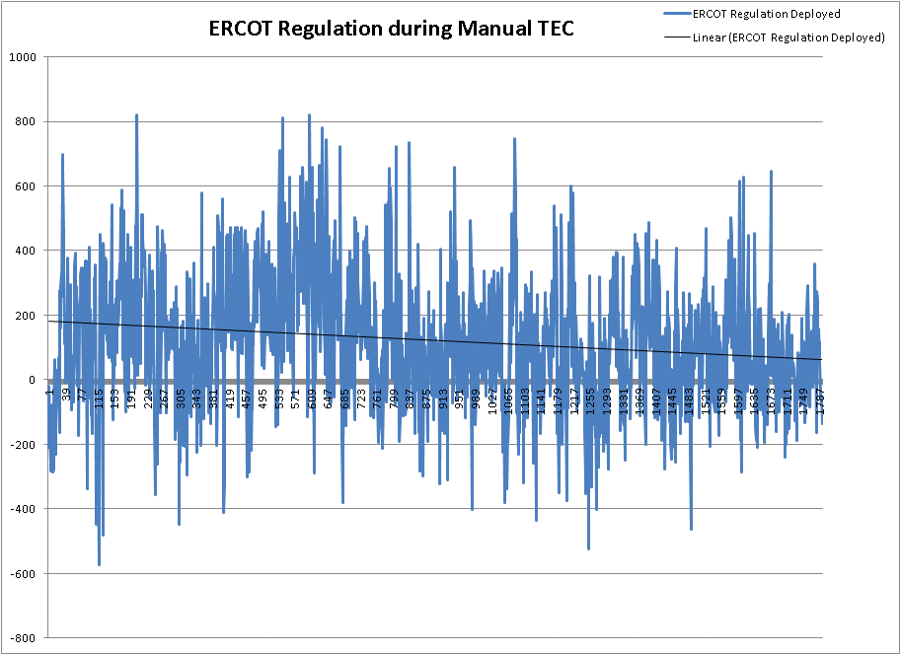

Slide 7
Manual Time Error Correction Procedure
When time error is equal to or greater than +/- 30 seconds, ERCOT may initiate a time correction
Time Error Corrections normally start and end on the hour or half-hour
The Time Error Correction will be ended when the error is less than +/- 27.5 seconds.
The time correction may be postponed if it is determined that load patterns in the immediate future will result in the desired time correction
However, the accumulated time error should not be allowed to exceed thirty-two (32) seconds.
ERCOT will not take any action if accumulated time error is trending towards zero

Slide 8
NERC BAL-004 Standard
R1. Only a Reliability Coordinator shall be eligible to act as Interconnection Time Monitor.
R2. Each Balancing Authority, when requested, shall participate in a Time Error Correction by one of the following methods:
R2.1. The Balancing Authority shall offset its frequency schedule by 0.02 Hertz, leaving the Frequency Bias Setting normal; or
R2.2. The Balancing Authority shall offset its Net Interchange Schedule (MW) by an amount equal to the computed bias contribution during a 0.02 Hertz Frequency Deviation (i.e., 20% of the Frequency Bias Setting).
R3. Any Reliability Coordinator in an Interconnection shall have the authority to request the Interconnection Time Monitor to terminate a Time Error Correction in progress, or a scheduled Time Error Correction that has not begun, for reliability considerations. R3.1. Balancing Authorities that have reliability concerns with the execution of a Time Error Correction shall notify their Reliability Coordinator and request the termination of a Time Error Correction in progress.

Slide 9
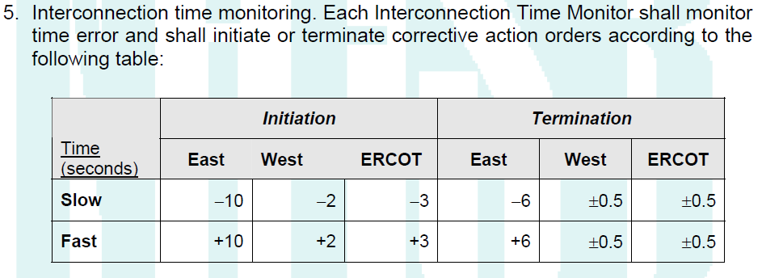
NAESB Manual TEC procedure
Business Practices Requirements:
1. Each Balancing Authority shall participate in Time Error Correction unless it is
operating asynchronously to its Interconnection.
1.1. Balancing Authorities operating asynchronously who establish their own time
error control bands, shall notify the Interconnection Time Monitor of the
bands being utilized, and shall also provide notification if they are changed.

Slide 10
Next Steps
Update the NAESB Manual Time Error Procedure
Update ERCOT Control Room Procedure
Send out the market notice with the start date

Slide 11
Questions??

