Slide 1
NAESB WEQ OASIS Subcommittee Report
to the
NAESB WEQ Executive Committee
October 24, 2017
Review and discuss the recommendation to support WEQ 2017 Annual Plan Items 2.a.i.1/R05019 and 5.a/R09003 – Short-Term Firm Preemption and Competition (OATT Section 13.2 and 14.2), and Add language to WEQ-001-4 Online Negotiation and Confirmation process to clarify Table 4-3
OASIS Subcommittee Co-Chairs
Alan Pritchard, Duke Energy JT Wood, Southern Company
Matt Schingle, MISO Ken Quimby, Southwest Power Pool
Rob Arbitelle, SOCO

Slide 2
2017 Annual Plan items 2.a.i.1: Short Term Preemption and Competition and 2017 Annual Plan Item 5.a: Add clarifying language to WEQ-001 Table 4-3
OASIS Subcommittee recommendation voted out for Formal Comments at the Vancouver BC meeting in June 2017
Slated for completion in Q2 2017
Requested a 45 day formal comment period, due to complexity
OASIS Subcommittee delivered 2 Industry Review Sessions
7/11/2017 afternoon
7/26/2017 morning

Slide 3
Preemption and Competition Recommendation
Major Modifications
Defined time frame for Preemption and ROFR Process – Go/NoGo
Expanded notification/information to participants
New OASIS templates to support notifications
Pre-confirmed Challenger requirement
Opt-Out provision for Challenger
Transmission Provider provides information to Defenders with ROFR
Matching Profile and Remaining Profile
A Defender with ROFR “match” modifies an existing reservation
Partial Service allowable in certain circumstances

Slide 4
Preemption and Competition Recommendation
8 sets of formal comments returned by deadline
BPA, NCEMC, APS, OATI, Duke Energy, Southern Company, PJM, ISO/RTO Council
OASIS Subcommittee reviewed over 400 items
Dallas Face-to-Face – August 16-17
Conference call – September 13
Charlotte Face-to-Face – September 26-28
Conference call – October 6

Slide 5
Preemption and Competition Recommendation
Two sets of late formal comments from the OASIS subcommittee
BPA identified an inequity in the processing of ROFR requests in their formal comments.
All comments other than the inequity identified by BPA were reviewed, a modified recommendation was prepared, and on 9/27/17 it was voted out of subcommittee for submission as late comments. (Unanimously supported without objection.)
A solution to the inequity identified by BPA was reviewed, a recommendation representing a modification of the first set of late comments was prepared, and on 10/6/17 it was voted out of subcommittee for submission as late comments. (Balanced vote 8.2 in favor, 1.8 opposed, with abstentions by MISO and SPP)
An additional set of late formal comments addressing the inequity was filed jointly by BPA and SOCO. It has not been considered in detail by the OASIS subcommittee.

Slide 6
Preemption and Competition Recommendation
What is the inequity?
Under the draft standards, if a Challenger was granted partial capacity or withdrew after receiving a counteroffer, any capacity remaining after the Challenger’s final status was set was made available to non-ROFR Defenders. The inequity identified by BPA was that the ROFR Defenders who failed in their attempts to match were not granted any of that remaining capacity before it was offered to non-ROFR Defenders.

Slide 7
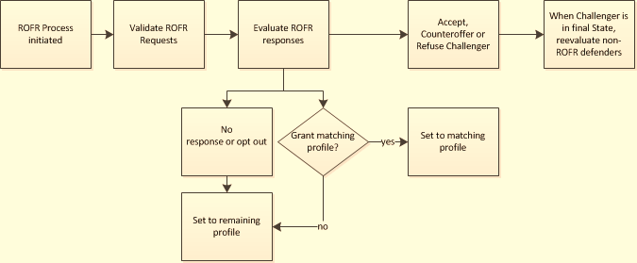
Preemption and Competition Recommendation
High level process flow for Preemption with ROFR – original concept

Slide 8
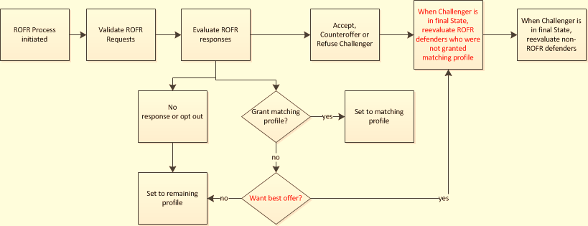
Preemption and Competition Recommendation
High level process flow for Preemption with ROFR with Best Offer

Slide 9
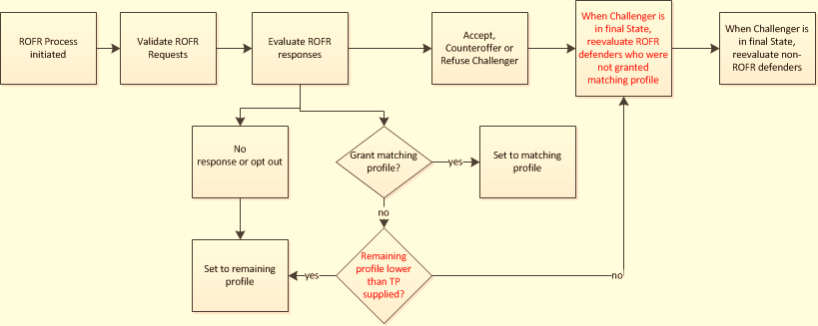
Preemption and Competition Recommendation
High level process flow for Preemption with ROFR – late comments by BPA & SOCO

