Slide 1
Strengthening Vulnerability Disclosure Across the Bulk Power System
Supporting NAESB WEQ Standards Development for 2026
NAESB WEQ BPS/CSS Meeting, December 15, 2025

Slide 2
Purpose of Today’s Briefing
A clear explanation of CVE and its role in supply-chain security
The implications of the March 2026 CVE funding cliff
The need for structured, vendor-driven vulnerability disclosure reporting
International and U.S. regulatory drivers accelerating action, FERC Order 912
Recommendations for NAESB’s 2026 standards-development efforts

Slide 3
Why We Are Meeting Today
Begin discussion of 2026 annual plan item 1b
FERC Order 912
The March 2026 expiration of stable CVE funding
Rising vulnerability volume across software supply chains
WEQ’s 2026 mandate to develop business practices for cybersecurity vulnerability disclosure
Increased federal and international expectations for transparency
Increased awareness from 60 Minutes Segment on Volt Typhoon (Cisco CVE)
The energy sector cannot rely on a single vulnerability database that may be unstable after early 2026.

Slide 4
The March 2026 CVE Funding Cliff
CVE funding faces significant uncertainty after March 2026. Potential impacts include:
Slower processing of CVE submissions
Loss of visibility for software vulnerabilities and risks
Reduced quality assurance / triage
Fragmentation across alternative databases
Delayed publication or inconsistent vulnerability naming
Greater dependency on vendor disclosures
NAESB must plan for continuity even if CVE output weakens.

Slide 5
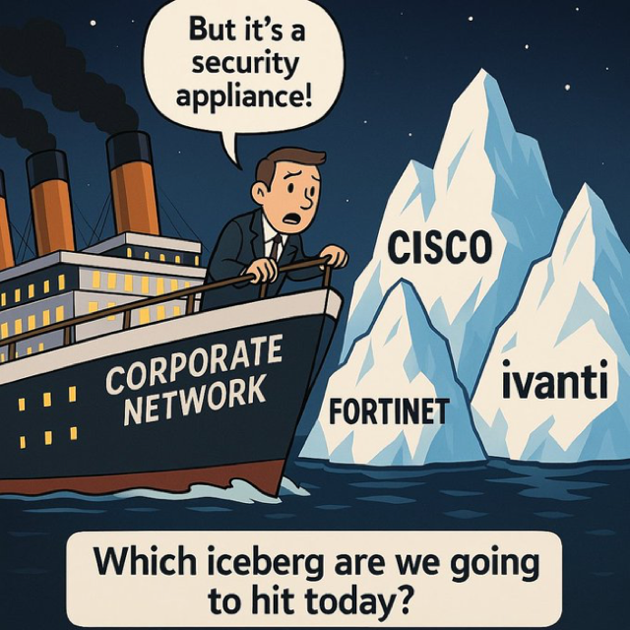
The CVE Ecosystem at a Glance
CVE provides:
Standardized identifiers for publicly known vulnerabilities
A common language for risk communication
The foundation for automated correlation in security tools
A critical support pillar for supply-chain cybersecurity (CIP-013, FERC 912)
However, CVE is not:
A complete vulnerability database
Providing transparency of all vulnerabilities affecting a product
A verification mechanism
A substitute for vendor confirmation
Guaranteed after March 2026

Slide 6
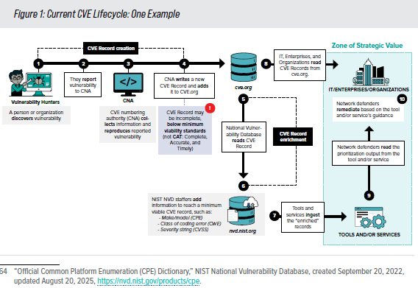
How the Vulnerability Reporting Process Works Today
Vulnerability discovered
CVE ID requested and assigned
Vendor investigates exploitability
Vendor issues Security Advisory
Vendor updates Product Vulnerability Disclosure Report (VDR)
Operators correlate against SBOM/HBOM
Risk decisions and mitigations implemented
Only product producers can confirm whether a product is actually vulnerable.

Slide 7
ICS/Bulk Power System Realities
Vulnerability management in the BPS is constrained by:
Long-lived devices (10–30+ years)
Firmware-level cryptographic dependencies
Maintenance windows measured in months
Safety and operational continuity requirements
Vendors with limited advisory output
Missing SBOMs
Components that never receive CVE IDs
Frequent ownership changes among manufacturers
This environment demands higher-quality vendor disclosures than IT systems do.

Slide 8
FERC Order 912
The existing CIP supply chain standards (currently, CIP-005-7, CIP-010-4, CIP-013-2) provide some fundamental risk management approaches, but FERC believes there are shortcomings:
Gaps in how entities identify, assess, and respond to supply chain risks.
Exclusion of Protected Cyber Assets (PCAs), which sit inside electronic security perimeters but outside the scope of protections.
Lack of accountability in tracking and documenting risk responses.
With Order 912, the Commission is making it clear: the previous approach is no longer enough.
Source: https://ampyxcyber.com/blog/closing-the-gaps-ferc-order-912-and-the-future-of-supply-chain-risk-management

Slide 9
BPS/ICS Vulnerability Example: Firmware-Level Exposure in Long-Lived Grid Equipment
Scenario Overview A widely deployed protective relay used across transmission substations contains:
An outdated RSA-1024 firmware-signing mechanism
A hard-coded certificate store that cannot be updated without a full firmware rebuild
A remote engineering-access interface disabled by default but often enabled for maintenance
No support for post-quantum or agile cryptographic primitives
This relay type is expected to remain in service until 2038–2045.

Slide 10
How the Vulnerability Emerges
A researcher discovers that the relay’s firmware verification process can be bypassed through:
A malformed signature that causes partial validation
An exploitable buffer condition during firmware parsing
A vendor library reused across several device generations
Working with Schneider Electric in preparation of two discovered vulnerabilities; CVEs forthcoming
The vulnerability does not initially receive a CVE because the vendor has not confirmed exploitability.

Slide 11
Operational Impact in the Bulk Power System
If exploited, the flaw could enable:
Unauthorized firmware uploads
Manipulation of trip settings
Protective relay mis-operation
Loss of situational awareness upstream
Cascading outage potential in transmission segments
Patch deployment requires multi-week outage coordination, engineering review, and field crew scheduling.

Slide 12
Why This Example Matters for Standards
This represents a typical BPS vulnerability because:
Patch windows are limited
Frequently Vendors are the only parties authorized to apply patches to their products
Devices have 20+ year lifespans
Firmware signing chains are classical and brittle
Vendor confirmation is the only authoritative source
ICS vulnerabilities often surface outside traditional CVE pipelines
BPS equipment illustrates why NAESB needs structured vendor disclosure, signed VDRs, SBOM-to-VDR correlation, and fallback channels independent of CVE stability.

Slide 13
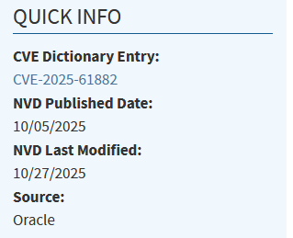
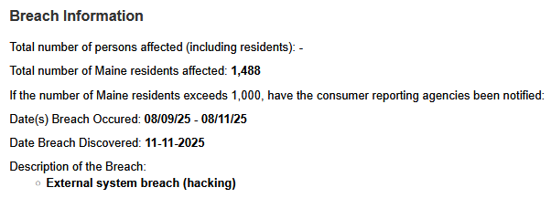
Oracle E-Business actual breach CVE-2025-61882
There are times when Vendors fail to disclose CVE information publicly on a timely basis
Source: https://www.maine.gov/agviewer/content/ag/985235c7-cb95-4be2-8792-a1252b4f8318/6de24e56-1806-4f42-853e-6c505ee1427f.html

Slide 14
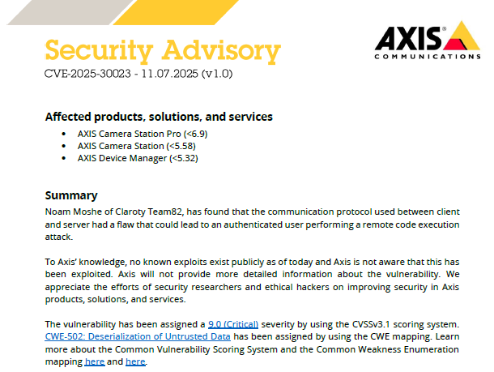
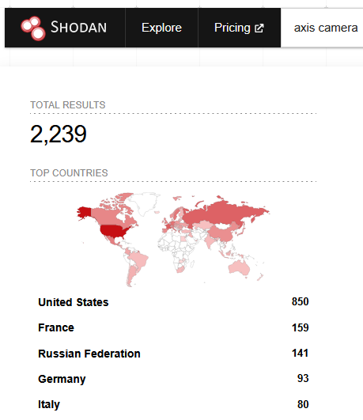
Known Vulnerabilities in AXIS Video Cameras

Slide 15
R Street & National Security Concerns
R Street notes that CVE is:
“Hidden infrastructure essential to national security, but chronically underfunded.”
Risks from underfunding include:
Slowed publication
Backlogged vulnerability requests
Gaps in coordinated disclosure
Unreliable reference data
Lack of visibility into new software vulnerabilities
This directly affects energy-sector operators who depend on consistent identifiers and timely reporting or risks.

Slide 16

International Momentum & Regulatory Drivers
NERC & FERC
FERC Order 912: Software supply-chain transparency
NERC Vendor Risk Management Guidelines
NIST and CISA
SP 800-161 SCRM standard (IEC 29147) and Secure Software Development Framework, SP 800-218
CISA Secure by Design Software Acquisition Guide best practices, https://cisa.gov/sag
European Union
Mandatory vulnerability disclosure
Strong supplier obligations for security lifecycle (SBOM’s)
Germany
Explicit vulnerability-reporting mandates tied to national readiness
Source BSA: https://www.bsa.org/policy-filings/the-cyber-harmonization-cafe-improving-cyber-outcomes-by-creating-one-menu-for-many-diners

Slide 17
Defining Reportable Vulnerabilities for 2026 Standards
NAESB should include:
CVE-identified vulnerabilities
Product Vulnerability Disclosure Reports (VDR) from product producers (CARFAX report for software)
Vendor-confirmed vulnerabilities without CVE
PQC migration blockers
Cryptographic agility gaps
Identity/firmware signing chain weaknesses
Vulnerabilities revealed through BOM analysis
Quantum-relevant issues must be included even if CVE does not assign an ID.

Slide 18
Distinguishing the Key Artifacts
Artifact | Owner | Purpose | Machine-Readable | Value
CVE | CNA | Identifier for public vulnerabilities | Partial | Baseline taxonomy
Security Advisory | Vendor | Disclosure of specific vulnerability | Yes (CSAF) | Actionable guidance
VDR | Vendor | Full list of vulnerabilities in a product | Yes | High-confidence source
SBOM/HBOM | Vendor | Software/hardware/component inventory | Yes | Enables correlation
Operators must rely on all four, not CVE alone.

Slide 19
Authenticity and Provenance of Vulnerability Data
Why It Matters Energy-sector operators increasingly rely on machine-readable disclosures (CSAF, VDRs, SBOM correlations). Without strong authenticity and provenance controls, adversaries can tamper with:
Vendor advisories
VDR content
Machine-readable security feeds
CVE references
Patch metadata
Required Controls for NAESB WEQ Standards
1. Digital Signatures
2. Hash Verification
3. Authenticated Distribution Channels
4. Versioning and Source Traceability
5. Provenance Metadata Requirements
6. Prevent Typosquatting
7. Verified trustworthiness of vendors and products

Slide 20
Minimum Vendor Reporting Requirements (Proposed)
NAESB WEQ should require vendors to:
Issue signed Security Advisories for all confirmed vulnerabilities
Maintain a continuously updated machine-readable VDR
Provide CSAF Profile 4 advisories
Correlate advisories to SBOM components consistent with NIST Guidelines
Disclose cryptographic agility and PQC readiness blockers
Confirm exploitability for each CVE that mentions their products
Product Patching schedules for vulnerabilities and response time objective

Slide 21
Authenticity & Provenance Requirements
All advisories, VDRs, and machine-readable files should be:
Digitally signed
Hash-verified
Distributed through authenticated channels
Version-controlled
Traceable to the issuing vendor
Placed at a well-known, trusted location to avoid typosquatting
This aligns directly with NERC CIP-005, CIP-013, and NIST and CISA secure-by-design principles.

Slide 22
Fallback Path if CVE Output Degrades After March 2026
Operators should maintain continuity by relying on:
Vendor-signed VDRs
CSAF advisories
SBOM/HBOM/CBOM analysis
Internal vulnerability registries
Industry-operated consortium databases
Machine-readable advisory feeds
Shared WEQ/CIP vulnerability clearinghouse
Sharing product trust declarations following a risk assessment
NAESB should document these fallback paths in its 2026 business practices.
.

Slide 23
Alignment with the NAESB 2026 WEQ Annual Plan
Supports:
Item 1(b): Develop business practice standards for cybersecurity vulnerability disclosures.
Item 3(a/b): Evaluate and modify cybersecurity business practices to support NERC CIP and FERC directives.
Harmonization of cybersecurity standards with the software industry (BSA)
This briefing provides the foundation for that standards effort.
This briefing provides the foundation for this standards effort.

Slide 24
Recommended NAESB Actions for 2026
Define minimum vendor vulnerability-reporting requirements
Publish WEQ model contract language
Require machine-readable CSAF and VDR formats at known locations (URL)
Include quantum-relevant vulnerabilities and PQC blockers
Create a WEQ SBOM/VDR/CVE correlation framework
Develop WEQ guidance on fallback reporting workflows
Launch a WEQ–NERC task force on vulnerability disclosure standards and harmonization

Slide 25
Recommended Timeline (Jan 2026 – Dec 2026)
Q1 2026
WEQ discuses/develops initial standard concepts/principles
Vendor contract language released
Define reportable-vulnerability categories
Q2 2026
Template VDR and CSAF profiles drafted
Q3 2026
Draft business practice standards circulated for industry comment
Q4 2026
Final WEQ standards adopted
Implementation coordination with NERC and FERC

Slide 26
Summary
The CVE funding cliff introduces real operational risk for the sector
Vendor-driven, verifiable disclosures must become the new baseline
Quantum inventory exposes where long-term vulnerabilities can persist
NAESB WEQ is positioned to lead the sector on standardized vulnerability reporting
The recommendations in this briefing provide a concrete, actionable roadmap for 2026
Continuous monitoring for software vulnerabilities requires automation (130 CVE/DAY) and a rapid risk
response

Slide 27

Thank you and happy holidays
Dick Brooks
Email: dick@businesscyberguardian.com
Tel: +1 978-696-1788
https://businesscyberguardian.com

