Slide 1
Common Grid Service Terms Motivation for NAESB Standards Request R22001 NAESB WEQ-BSP Meeting Presentation 14 June 2022
Reliable
Resilient
Secure
DOE Grid Modernization Laboratory Consortium (GMLC)
Grid Modern-
ization
Rich Brown, Principal Investigator
Lawrence Berkeley National Laboratory
Steve Widergren, co-PI
Pacific Northwest National Laboratory
Sustain-
able
Affordable
Flexible

Slide 2
Topics
DOE and national labs interest in grid services
GMLC common grid services and energy systems interface project
Standards request R22001
Example grid service types
Desired outcome of effort
Potential implications for retail-level flexible resource coordination

Slide 3
DOE & National Lab Grid Service Interest
Trends: operating the electric grid is growing in complexity
Variable renewable resource growth challenges the traditional operating paradigm
Electrification of more end-use applications increasing demand
Affordable communications and intelligence appearing at distribution level (infrastructure and customers)
Greater opportunities for flexible grid-edge resources to coordinate their operation with the system
Flexible grid-edge resources: responsive generation, storage, and demand
Challenge: integration and interoperation of vast numbers of devices, systems, and participants
Significant equipment purchased, operated, and maintained by non-grid entities
Technology is changing and mixture is constantly evolving
Many technology suppliers with various novel solutions
Many jurisdictions with different rules, regulations, and business processes

Slide 4
GMLC Grid Service and ESI Project
Overview & Problem Statement
To cost-effectively coordinate the operation flexible grid-edge resources at scale of millions need simplified ways to integrate and interoperate these resources
Common grid services
Types of performance-based agreements between grid operations and customer-owner-operations
Must be adjustable for different regional jurisdictions
Industry consensus to encourage reference and adoption
Standard Energy Services Interface (ESI)
Facilitate development of communication interface standards agnostic to flexibility equipment type
The ESI is applicable to all types of equipment that can perform the agreed upon service
Boundaries of responsibility on either side of the interface are clear and protected
Embraces distributed decision-making coordination
Results in modularity and loose coupling of the interacting system components.
Multi-lab participation: LBNL (lead lab), PNNL, NREL, ORNL, ANL

Slide 5
Why Engage at NAESB
Wholesale electricity markets already designed to work with changing resource mix
Wholesale grid services embrace a variety of resource mixes
Independent system operation and markets service all participants
Strive for level playing field
Room for improvement
Jurisdictions use somewhat different names for similar grid-services
Ensure that operational objectives (purpose/use) separate from service definition
Commonality breeds consistency and clarity to ease integration and interoperation of all participants
NAESB appropriate forum for industry discussion and deliberation
Members include system operations and market organizations with subject matter expertise
Work products address industry terminology and business processes/practices
Provides a consensus-based process

Slide 6
Standards Request R22001
Objective:
Classify common grid services that accommodate the diverse grid needs in different regions
Define common grid service types for wholesale power system interactions
Derive commonalities and important variations found in existing grid services
Meet near to mid-future needs gathered from major US ISO/RTOs and utilities
Accommodate specialization: performance characteristics and expectations
Qualification, performance expectations, monitoring, reconciliation, and settlement vary by operational policy of each region
But defining common policy is beyond the scope of this proposal
Benefit:
Provides consistent service-type names, definitions, and performance characteristics
Encourages adoption of consistent terminology in wholesale markets
Provides starting place for retail-level grid service interactions with flexible, grid-edge resources

Slide 7
Service-Oriented Principles
Operational objectives describe why a service is used
Use cases helpful for describing the desired performance characteristics from a service
Examples: schedule energy to meet peak load forecast, or reserve energy for outage contingency
Boundaries of responsibility are clearly understood between service requester and provider
Service definition says what is to be performed – not how
Example: generation needs to be at nominal power level 100 MW in 10 minutes and maintained for 1 hour
Any equipment type that meets the performance requirement can provide the service
Service provider understands what to do, where, and when – not why
The service requestor’s reasons for invoking the service (the operational objectives) are hidden
Example: a gas-turbine generator does not need to know it is scheduled for peak-load coverage
Benefits
Decouples areas of concern - makes integration simpler, cleaner, modular
Same service can be used to address multiple objectives
Accommodates service provider technology decisions within performance requirements

Slide 8
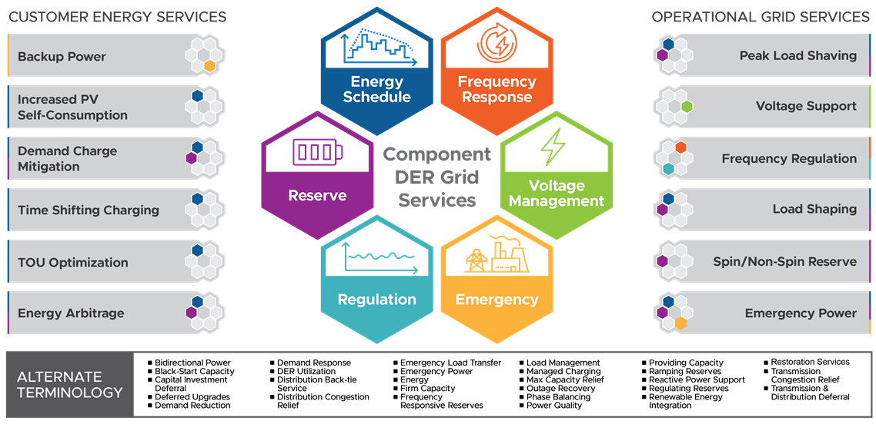
Example Grid Service Types
Provider Operational Objectives
Grid Operational Objectives
Courtesy of Chris Irwin (DOE) and Cortland Johnson (PNNL)

Slide 9
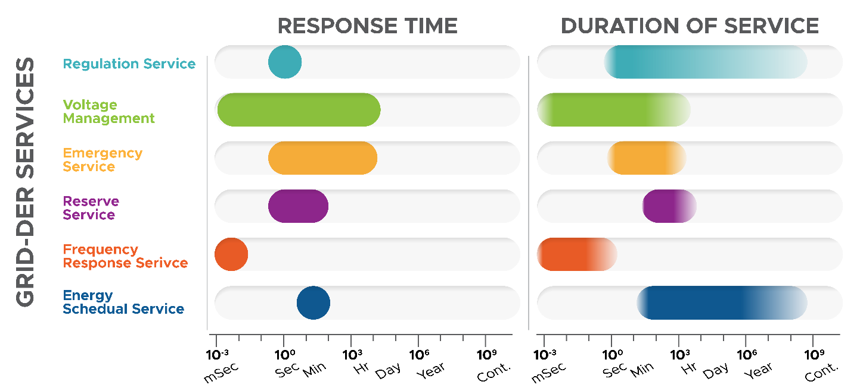
Illustrative Performance Expectations

Slide 10
Examples of Multiple Terms
Grid Service Types |  | FERC 888 (1996) | NERC IOS (2002) | CAISO | PJM | Hawaiian Electric
Energy scheduling |  | Scheduling, System Control and Dispatch |  | Day-Ahead & Real-Time energy | Energy | Energy
 | Frequency Response | Regulation and Frequency Response | Frequency Response |  |  | Inertia; Primary Frequency Response; Fast Frequency Response
 | Regulation |  | Regulation | Regulation Up; Regulation Down | Regulation (Traditional and Dynamic) | Regulating Reserves
 | Reserve | Operating Reserve - Spinning Reserve and Supplemental Reserve | Contingency Reserve | Spinning Reserve; Non-Spinning Reserve | Synchronized Reserve; Non-Synchronized Reserve; Secondary Reserve
 | Load Following (Ramping Reserve) | Energy Imbalance | Load Following | Flexible Ramping (in Real-time Market) |  | Load Reduce; Load Build
 | Voltage Management | Reactive Supply and Voltage Control from Generation Sources | Reactive Power Supply from Generation Sources | Voltage Support | Voltage Control | Voltage Support
 | Emergency |  | System Blackstart Capability |  | Black Start Service

Slide 11
Desired Outcome of Effort
Classification of a (small) set of grid services
Common names for these grid-service types
Clear definitions of the service types
Parameterized performance expectations (i.e., electrical attributes, timing attributes)
Accommodate necessary specialization
Effort does NOT,
Propose a uniform market policy on services
Prescribe a solution for DER integration into wholesale electric markets
Specify DER management technology or platforms
Recoup lost investments in cryptocurrencies

Slide 12
Retail-level Flexible Resource Implications
Should the wholesale electric area gain alignment on grid service type names and definitions
Retail electric area offered a starting point for retail grid services
Appropriate for customers or aggregators with flexibility resources
Shift focus from equipment-oriented unique initiatives to service-based initiatives
Reduce special programs for PVs, EV charging, electric storage, and demand response
Increase service programs that focus on performance, not equipment type
Simplifies integration and participation of flexibility resources in distribution operations
Potential NAESB implication
Provide preliminary material for Retail Electric Quadrant service terms and definitions

