Slide 1

NAESB REQ.21 Update
Dr. Martin J. Burns, Hypertek Inc. for NIST
February 21, 2014

Slide 2
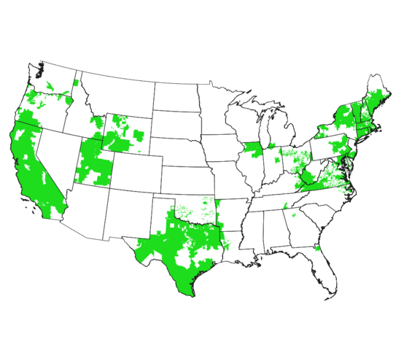
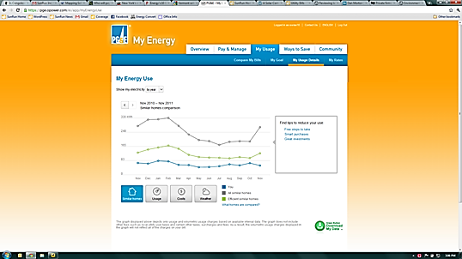


Green Button Initiative
Enables electronic consumer access to energy data and supports development of ecosystem (apps)
Available to 42+ million customers now and 59+ million in the future based on utility commitments
Result of collaboration among White House, DOE, NIST, state regulators, utilities, vendors, SGIP, and North American Energy Standards Board
Green Button Download My Data and Green Button Connect My Data
Map of Green Button Commitments

Slide 3











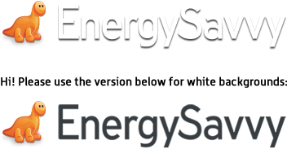






Green Button to Spurs Innovation in New Areas
Insight: entrepreneur-created web portals analyze energy usage and provide actionable tips;
Heating and Cooling: customized heating and cooling activities for savings and comfort;
Education: community and student energy efficiency competitions;
Retrofits: improved decision-support tools to facilitate energy efficiency retrofits;
Verification: measurement of energy efficiency investments;
Real Estate: provide energy costs for tenants and/or new home purchasers; and
Solar: optimize the size and cost-effectiveness of rooftop solar panels.
Notes:
3

Slide 4
Federal Government Interest in Data Access
Smart Disclosure
  Timely release of complex information and data in standardized, machine readable formats in ways that empower and enable consumers to make informed decisions
Open Data Initiatives
  Make government data and other public information widely available and useful
  Energy.data.gov, …
My Data Initiatives
  Support consumers and others to access their own data, preserving privacy and maintaining security
  Blue Button, industry-led Green Button, …
  Green Button Download My Data
  Green Button Connect My Data
Presidential Memorandum
  Section 3 : (b) To facilitate agency management of energy usage information in Green Button

Slide 5
Green Button for America team
Federal Government: OSTP, NIST, DOE, CEQ +
  New Presidential Innovation Fellows: John Teeter (NIST), Matt Theall (DOE), Charles Worthington (DOE)
Goals:
  Grow (x2) Green Button ecosystem (utilities and vendors commitments and implementations, challenges, …)
  Improve Green Button data consistency (testing and certification, interaction and support for implementers, …)
  Leverage Green Button in Federal facilities (GSA) as part of fed gov’t response to climate action plan
Kickoff event: Green Button Developer Day
  July 2013, significant momentum, California PUC support, standing room only at Silicon Valley hotel, …

Slide 6
Green Button status
Customers with access
  Green Button Download My Data: 42MM implemented, 54MM committed (48 utilities),
  Green Button Connect My Data: utilities implemented (beta) – SDG&E, PG&E, Pepco, PECO, … (16MM)
Residential / commercial
  Implementations by utilities cover both (not just residential)
Standard update cycle – NAESB ESPI revision
  Initiating in February 2014
  Will incorporate lessons learned, schema modifications developed in UCAIug’s OpenADE task force
Testing and Certification
  Green Button Download My Data dry run underway
  Connect My Data Test Plan in development

Slide 7
How to Reduce Barriers to Penetration
Standards
  Consensus among stakeholders
  Maintenance and evolution
Barriers Impede Penetration of New Technology
NAESB
Activation
Energy
Potential
Energy
Interoperable products and services
Benefits Drive Penetration of New Technology
Green Button as Catalyst Speeds Penetration
UCAIug
Users Groups
Implementation agreements
Labeling and Test Certifications
Issues resolution
OpenESPI
Reference Implementations
Open Source Running Code
Development projects
“golden unit”

Slide 8
Green Button Data Exchange
Green Button Connect My Data
Data Custodian
Third Party
Third Party Registration
Web Service Provider
Web Service Consumer
Automated Transfer
Web Portal
One-time Authorization
Web Portal
Retail Customer
Green Button Download My Data
User (agent)

Slide 9
Green Button Evolution
Aneesh Chopra Call to Action
Connect My Data
American Energy
Data Challenge Launch
9/2011
10/2012
11/2013
NAESB ESPI Standard Ratified
Presidential Memorandum on Federal Agencies
HEY Update w/ Green Button
10/2011
12/2013
PG&E, SDG&E Release Apps
4/2013
Portfolio Manager Upgrade
Green Button DMD Certifications Start
1/2012
DOE Apps
for Energy
7/2013
2/2014
5/2012
2011
2012
2014
2013
0 Customers
(Download My Data)
12 MM Customers
26 MM Customers
42 MM Customers

Slide 10
SGIP PAP20: Green Button ESPI Evolution Roadmap Going Forward …
SGIP PAP Activities:
Coordinates with
PAP 20
CSWG
SGTCC
SGIMC
Requirements for Green Button and ESPI Rollout
Privacy assurance recommendations
Test plan consistency
Requirements for standards and test criteria
Facilitate/Coordinate SGIP interactions
Cybersecurity recommendations for EUI exchanges
ITCA assurances
Education on implementation strategies, standards, use cases and test criteria
Specification Deliverables:
Standards
(NAESB)
REQ.18/WEQ.19 Maintenance Update
ESPI Errata Update
REQ.21/REQ.22
ESPI New Reqs Update
International Version
T&C
(UCAIug)
Green Button Download My Data Test Plan
Green Button Connect My Data Test Plan
UCAIug ITCA
Implementation
(EnergyOS)
Green Button SDK
OpenESPI
Current Effort

Slide 11

Green Button Testing and Certification
Implementation Agreements
Application Profiles
Test Requirements
Requirements Breakdown
Requirements verification
Test Procedures
Software Implementation
Green Button Download My Data
ITCA
Standards Updates
Green Button Connect My Data
Certification Mark
Certification Process
Certification Bodies
Certified
Green Button Implementations

Slide 12
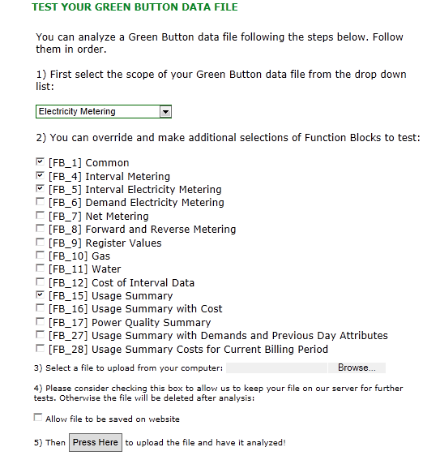
Testing a Green Button Data File
Select Common Scope
Edit Scope (Function Blocks)
Browse for file (IE9)
Drag/Drop (FF)
Allow us to save file
Analyze Results

Slide 13
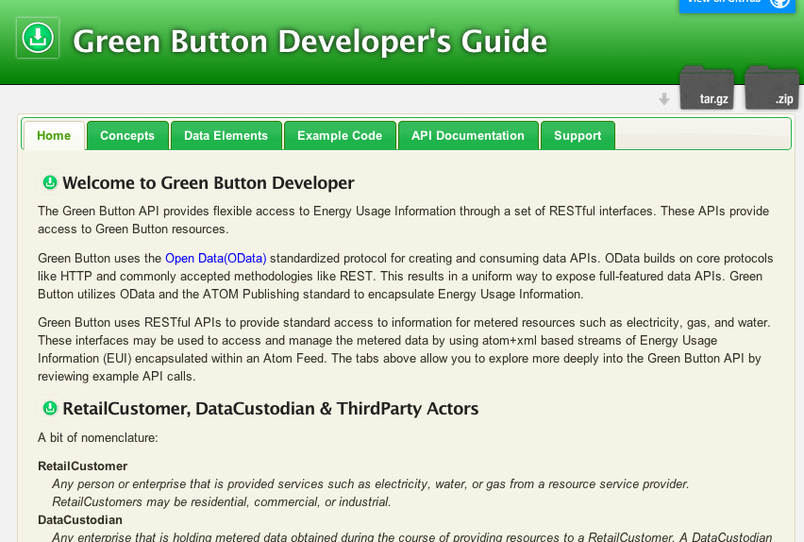
Sandbox Developers Guide

Slide 14
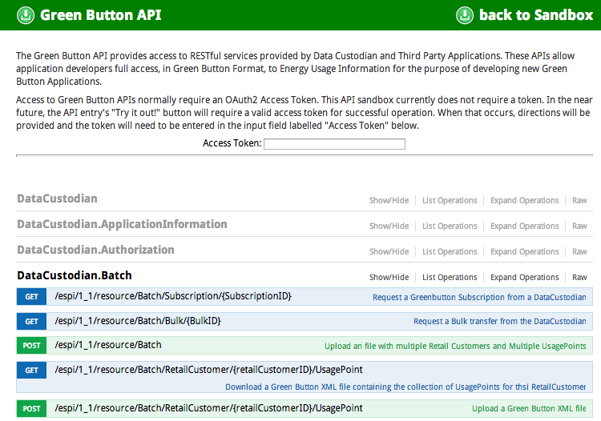
Green Button Live API Page

Slide 15
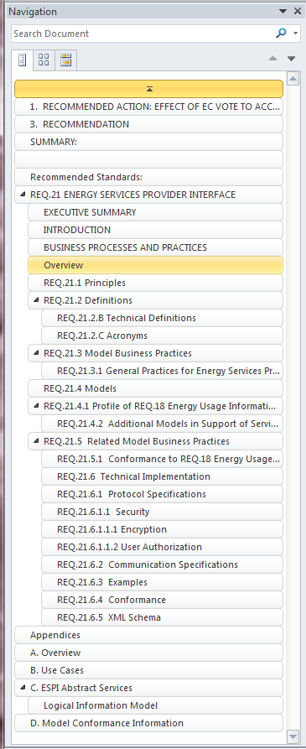
REQ.21 ESPI Revision
Personal Recommendations (not NISTs)
Enhance Descriptions and Field Definitions
Add REST Protocol Details
Add Cyber Security and Privacy Detail
Add Application Profiles
Add Function Block Descriptions
Remove Schema
Add HowTo Extend Section
Make Use Cases Normative

