Slide 1
NAESB Gas-Electric Harmonization Forum
Jerry Dempsey
Senior Vice President
Sheldan Perry
Manager of Gas Systems

Slide 2
Agenda Overview
Share experience and lessons learned when Wholesale Electric adopted Electronic Scheduling
Overview of Electronic Scheduling
Benefits to Wholesale Electric Industry
Gas Industry
Current Gas process flow
Concept of Electronic Scheduling for Gas Industry
Projected benefits to Gas Industry

Slide 3
Electronic Tagging Service for Electricity
Electronic Tagging Service (e-Tag) is governed by NAESB e-Tag Specification
Provides an open standard
Common NAESB data registry for entities provides foundation
Increases interoperability
Reduces errors
Regional Entities supplement standard with Business Process Requirements adapted to local needs
Currently captures 4,000+ initial requests every day across the USA, Canada, and Mexico

Slide 4
E-Tag Overview
E-Tag Primary Functions
Inform all involved parties simultaneously
Obtain approvals
A single “master” record
Notify appropriate reliability organizations
Critical information for Reliability, Transmission, and Congestion Management purposes
Back-bone to merchant operations, e.g., positions, checkouts, and settlements

Slide 5
E-Tag Services
Agent Service
Create and submit requests
Authority Service
E-Tag request communication and status management
Provides single “master” record
Approval Service
Evaluate and approve/deny e-Tag requests
Adjustments

Slide 6
E-Tag Overview
E-Tag creates a seamless agreement between all involved parties regarding
Planned physical flow
Transmission
Financial Responsibility
©2016 OATI, Inc.

Slide 7
High Level E-Tag/Scheduling Overview
©2016 OATI, Inc.

Slide 8
Benefits of E-Tag to Wholesale Electric
Transparency
Accessible to all appropriate parties
Standardization
Common processes across the industry
Consistency
Common NAESB data registry for entities
Efficiency
All entities involved will have identical view of the transaction
Significant reduction in manual process
Updates
Confirmations
Checkouts
Interoperability

Slide 9
Gas Industry

Slide 10
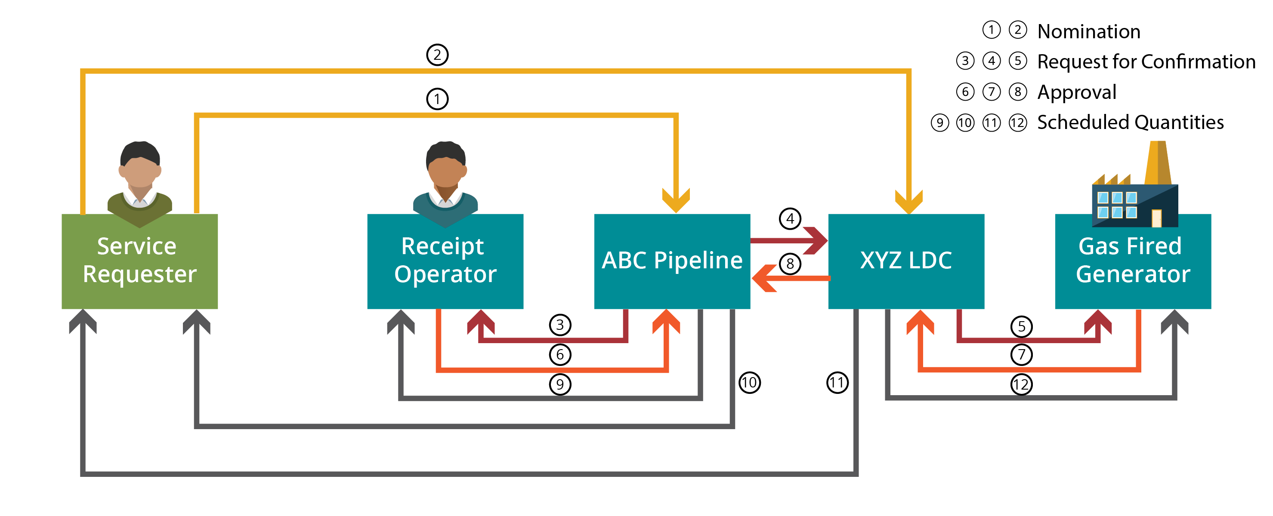
Current Gas Process Example
©2016 OATI, Inc.

Slide 11
Observations on Current Process
The current multi-step process occurs over a 3-4 hour period per nomination cycle
The service requester is required to separately nominate across multiple pipelines
The service requester receives confirmation of scheduled quantities separately from each pipeline
The Electronic Data Interchange (EDI) data set configuration process is challenging for all parties to the transaction
Multiple communication mechanisms for confirmations, i.e., email, fax, phone

Slide 12
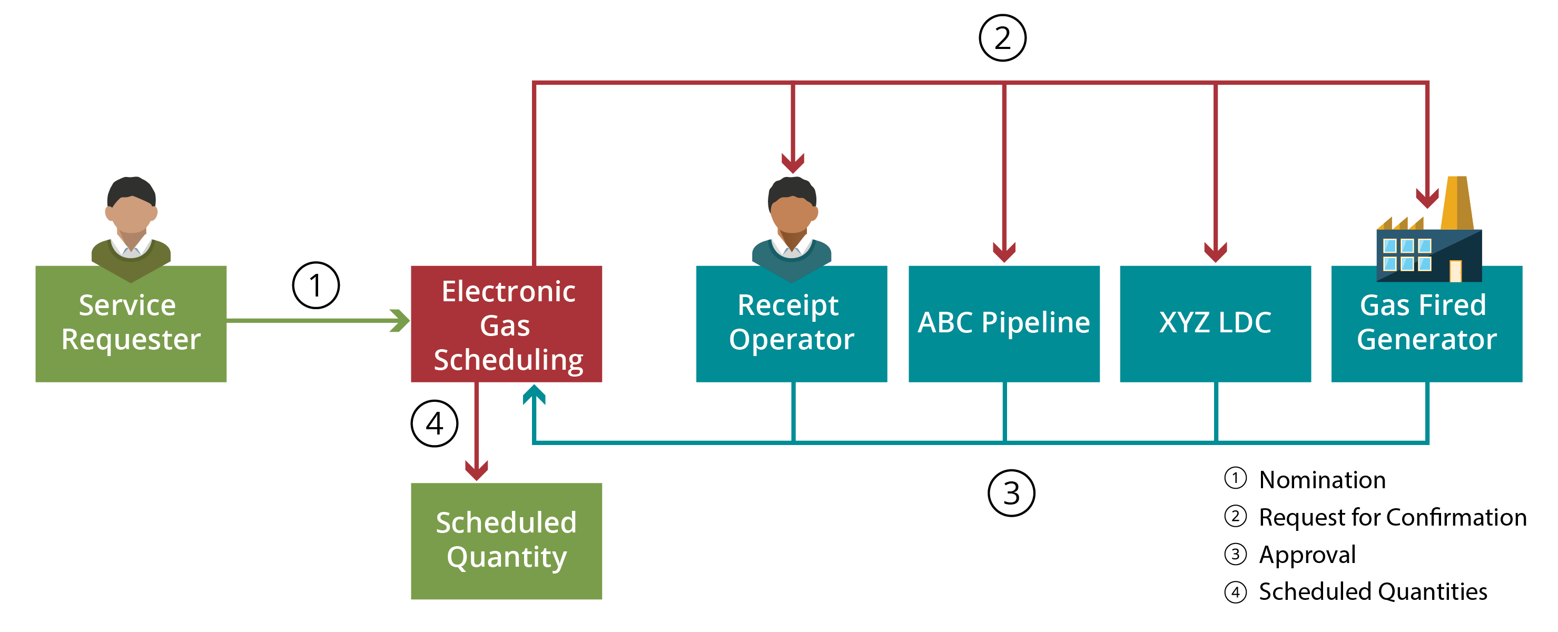
E-Tagging Concepts Applied to Gas
©2016 OATI, Inc.

Slide 13
Service Concepts
©2016 OATI, Inc.

Slide 14
Functions of Electronic Gas Scheduling
Streamlined Electronic Gas Scheduling Primary Functions
Simultaneously notifies all parties that a nomination has been initiated
Allows the parties in the transaction to approve the nomination
Nominated quantities are confirmed and scheduled in real time

Slide 15
Benefits to the Gas Industry
Enhances party-to-party communication
Reduces need for email, fax, and phone calls
End-to-end simultaneous notification and coordination to all interested parties in the transaction
Enables faster, computerized scheduling of shipper nominated and confirmed quantities

Slide 16
Benefits to the Gas Industry (Continued)
Facilitates Transparency in the Gas Scheduling Process
Accessible to all interested parties, i.e., shippers, operators, etc.
Standardized Streamlined Scheduling Process
Standard process across all pipelines
Common NAESB data registry, i.e., entities, locations
Efficiency
All parties involved will have identical view of the transaction
Significant reduction in manual process
Interoperability

Slide 17
Questions

Slide 18
Thank You
Jerry Dempsey
Sheldan Perry
Jerry.Dempsey@oati.net
763.201.2000

