Slide 1
Scheduling, Market Efficiency and Customer Impacts N. Jonathan Peress NAESB GEH Forum
February 2016

Slide 2
Presentation Summary
Scheduling and market liquidity
Pipeline utilization data review
Retail customer benefits from enhanced scheduling
Looking forward – Gas/Electric Coordination for a more dynamic, renewable and peakier electric grid
2

Slide 3
2014 Severe Weather Events
3

Slide 4
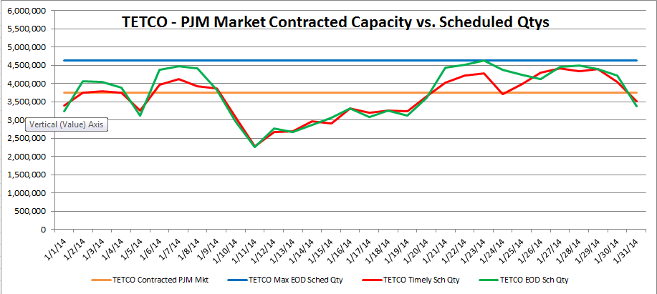
PJM East - During polar vortex
TETCO Pipeline – Market Contracted Capacity vs. Scheduled Qtys
Actual Performance
Performance Benchmark
4

Slide 5
Performance Benchmark
5

Slide 6
6

Slide 7
7
Notes:
Upon analyzing the data, what is the

Slide 8
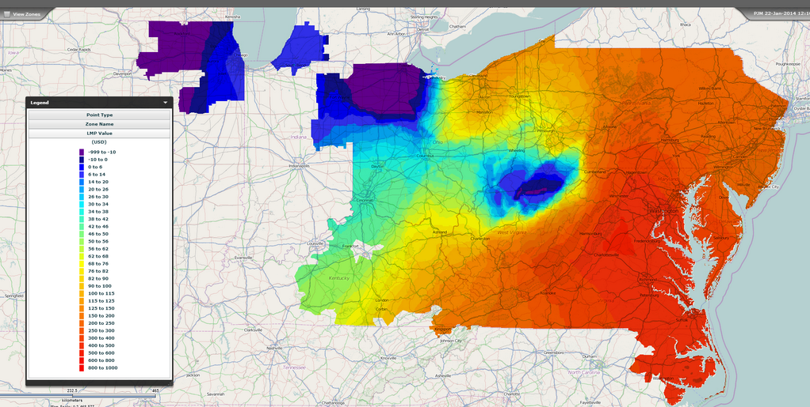
PJM Price “Heat Map” from January 22, 2014 shows price dislocation and high cost in PJM East.
8

Slide 9
Natural gas scheduling problems were the key contributor to operational challenges – and high operating reserve
costs – during this second period of cold weather. For example, to ensure that gas would be delivered to some
generators during the few hours per day they needed to be in service, generators were required to schedule gas
deliveries and operate for a full day at extremely high prices – even if less expensive power was available. Natural
gas scheduling issues caused most of the $597 million in out-of-market make-whole (uplift) charges for January 2014.
May 8, 2014 - Executive Summary – Page 4
9

Slide 10
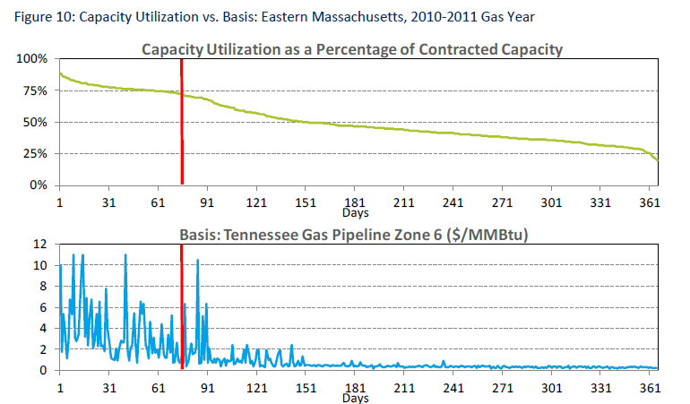
TGP 75% “Constraint Threshold” in New England Black & Veatch for NESCOE- April 2013
10

Slide 11
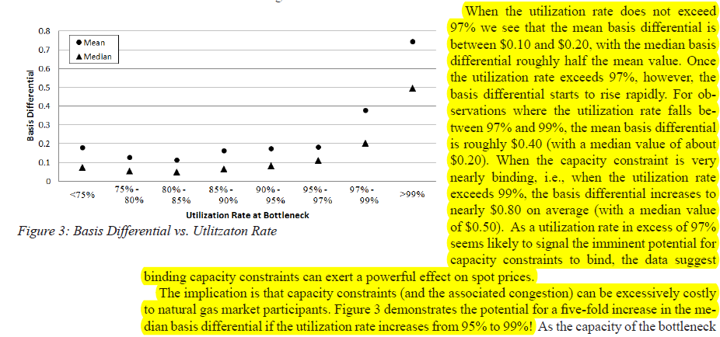
Western Hubs – 97% “Constraint Threshold”
Mason etal. (April 2014)
Gas generally flows from west to east between these two hubs, so that one may interpret the source of supply as represented by the trading hub in the western part of the state (the Opal trading hub) and the source of demand as represented by the trading hub in the eastern part of the state (the Cheyenne trading hub).
11

Slide 12
Additional scheduling cycles will diminish constraints, increase
“Constraint Threshold”, reduce LMPs and save customers money.
Savings from TGP in ISO-NE December 2012 to June 2015
on Days when Nat Gas Units Were on the Margin
12

Slide 13
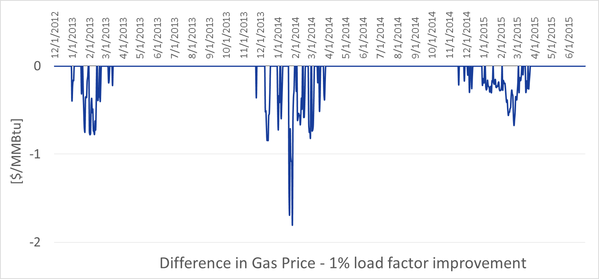
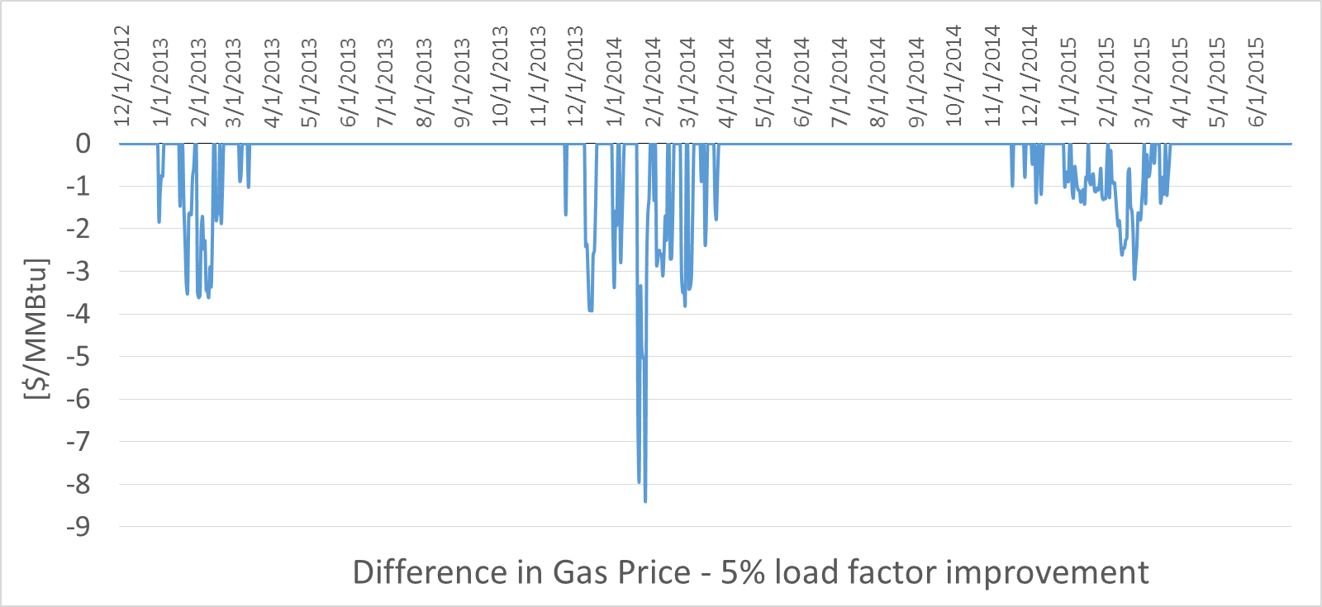
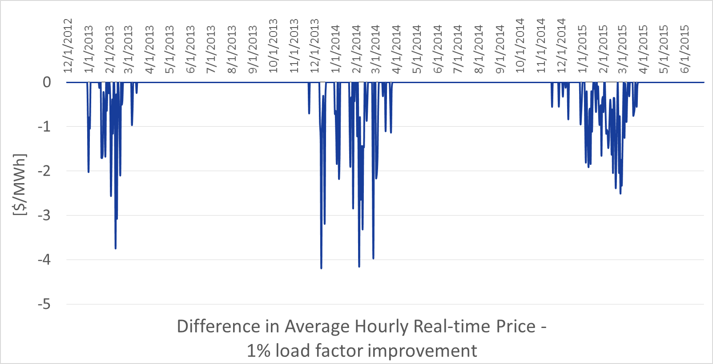
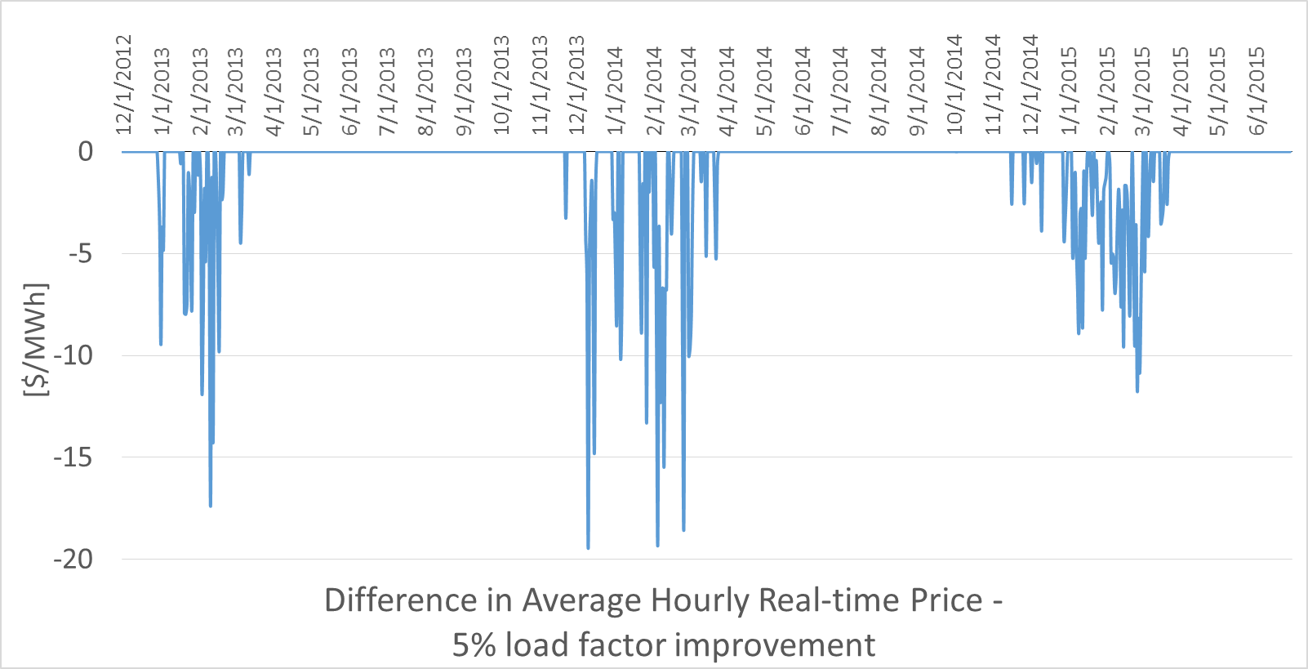
13

Slide 14
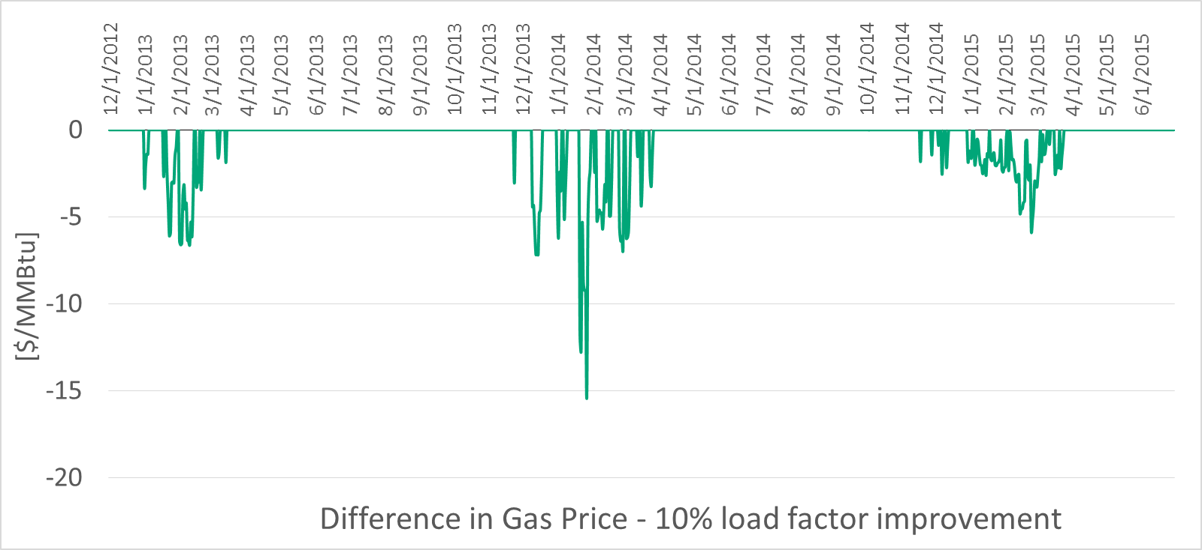
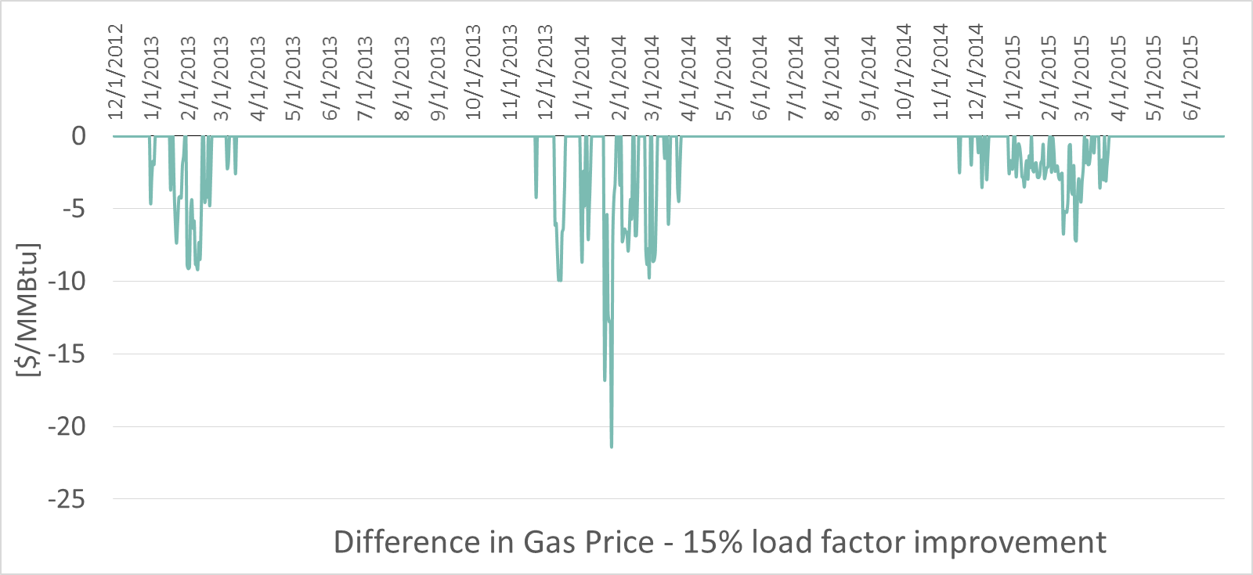
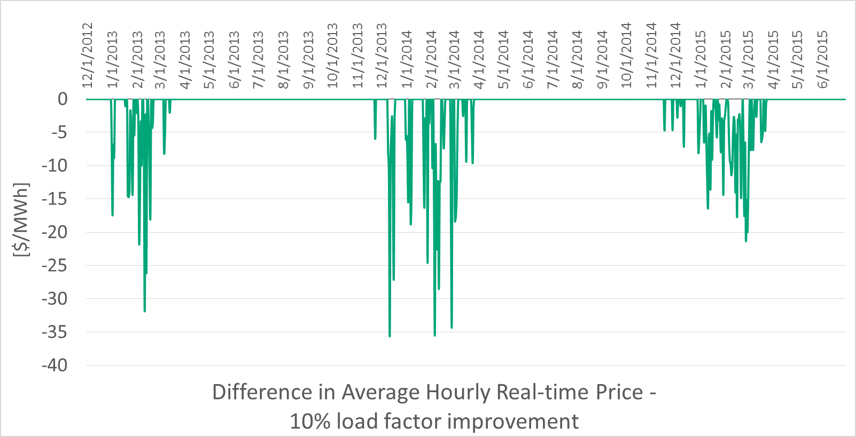
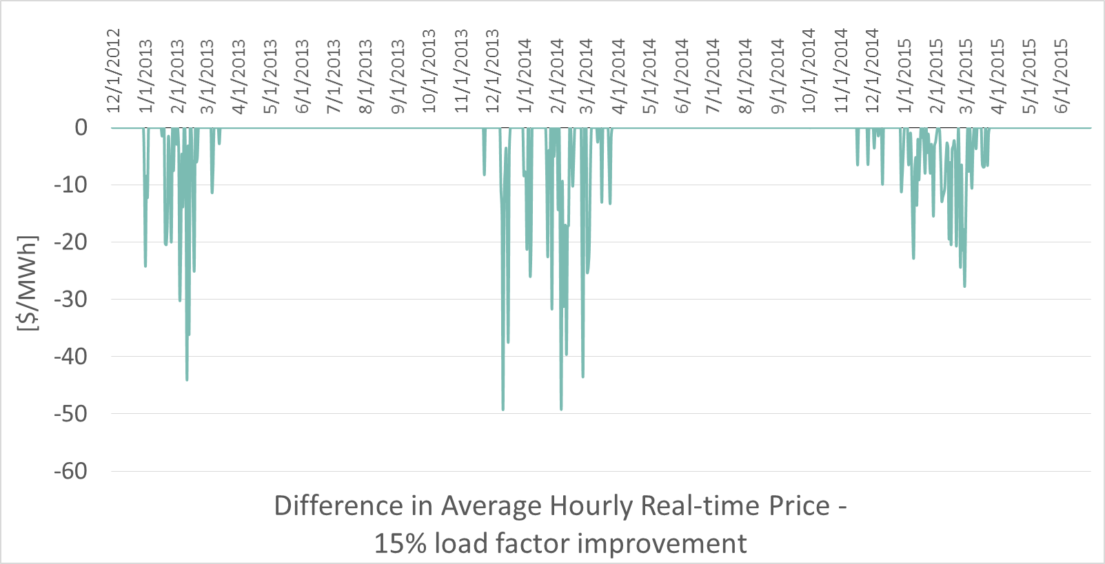
14

Slide 15
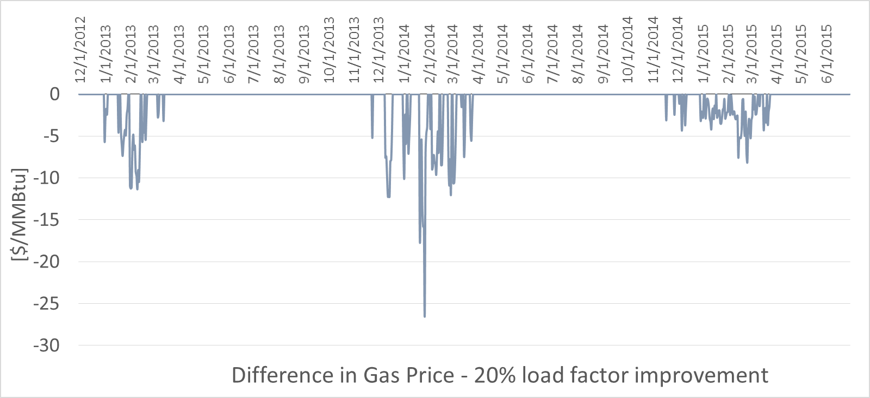
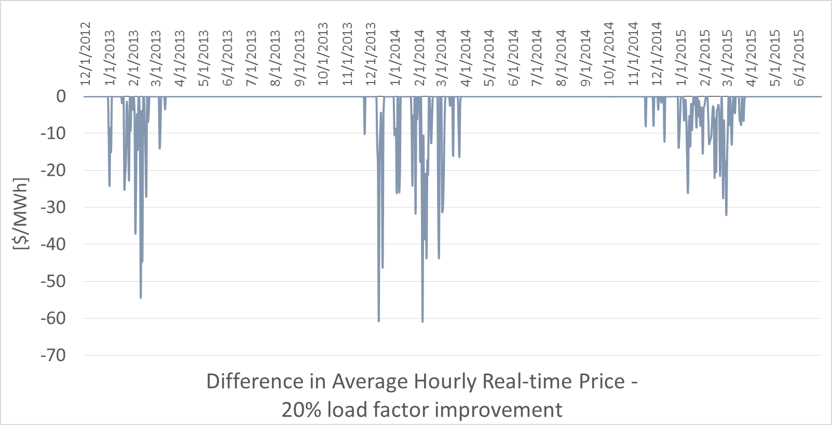
15

Slide 16
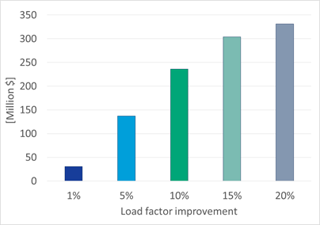
Savings from DTI in PJM East from Enhanced Scheduling December 2012
To June 2015 on days when Nat Gas Units on the Margin
16

Slide 17
Deliverability/Flexibility – Capacity Markets
Organized competitive markets
Pay for Performance = No fuel, No revenue
Not likely to increase merchant need for FT
Generator annual cap market revenue depends on 20-50 constrained (reliability) hours per year
Alternatives to FT are developing products and services (e.g., LNG storage, fuel oil)
Modeling validates alternatives to FT
Ancillary services also depend on flexible scheduling and flows
17

Slide 18
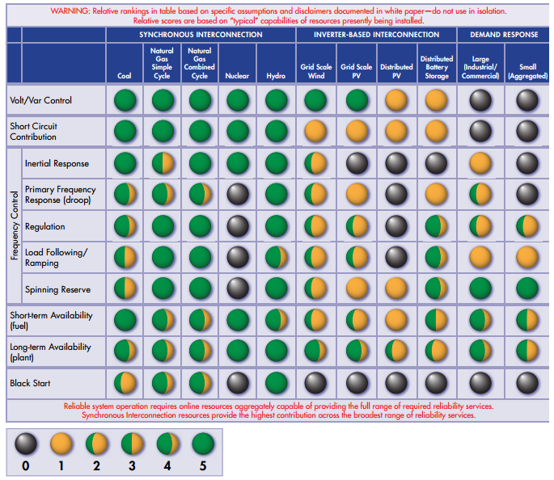
18
EPRI, Contributions of Supply and Demand Resources
to Required Power System Reliability Services, Feb. 2015

Slide 19
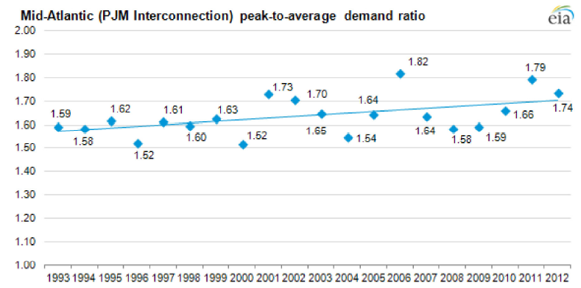
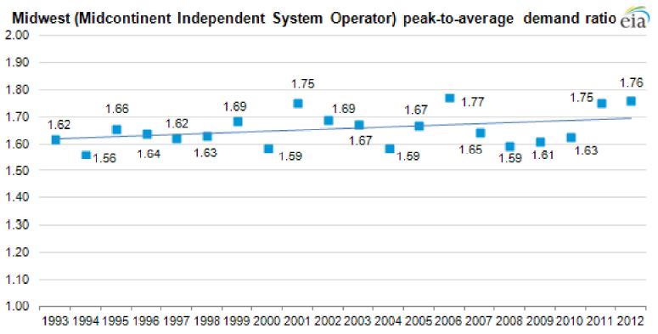
Peak-to-Average Electricity Demand is Increasing -Less Energy Market, More Ancillary Services Needs
19
Notes:
As the peak-to-average ratio rises, generators called on to meet peak-hour demand are running fewer hours and/or at lower output levels the rest of the year.

Slide 20
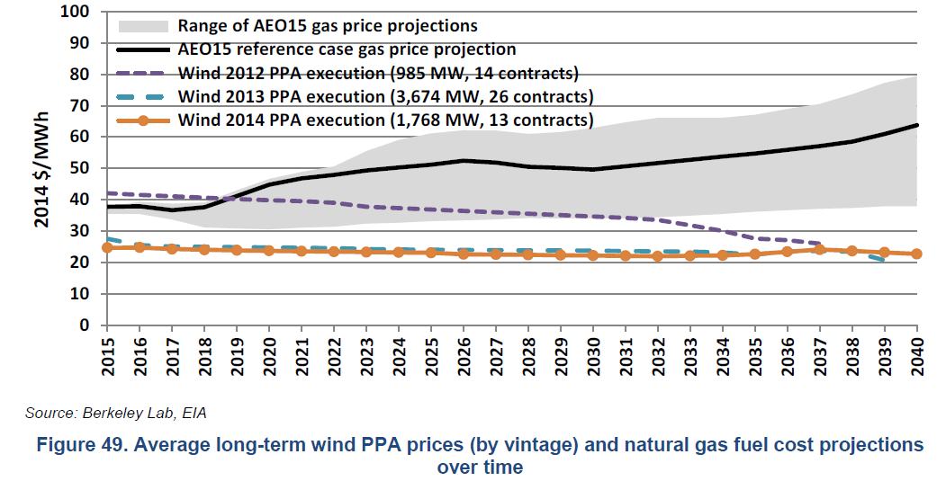
DOE/NREL: Wind Cost Comparison to Gas
20

Slide 21
Gas/Electric Coordination Scheduling Implications
As the peak-to-average ratio rises, generators called on to meet peak-hour demand are running fewer hours and/or at lower output levels the rest of the year.
As more renewables and DERs are added to the grid, ancillary services needs and values will increase.
Efficient price formation and capturing that value require more scheduling cycles and sub-day services from the wholesale gas market (e.g., Cal-ISO FRP, Duck curve).
A more dynamic, data driven grid will price based on the value of services (i.e., revenue opportunity).
Electric – hourly pricing; sub-hourly balancing; Gas ??
21

Slide 22
“There cannot be a smart, interactive grid unless the business rules governing the means by which gas is traded and dispatched are in sync with the evolving needs of the electric markets.” -EDF FERC Comments, November 2014
“We continue to recognize that additional intraday nomination opportunities could promote more efficient use of existing pipeline infrastructure and provide additional operational flexibility to all pipeline shippers,
including gas-fired generators.”
-Final FERC Order #809
April 2015
22

Slide 23
Thank you for the opportunity to share our perspectives!
23

Slide 24
Technical Appendix

Slide 25
Assumptions – TGP/DTI LMP Impact Analysis
Estimates based on scheduling Dec 1, 2012 – June 30, 2015
Assumed improvement in load factors (1-20%) from additional cycles on constrained days (load factor>75%) (for DTI>80%).
Counterfactual gas price with more cycles is estimated for constrained days.
Based on a price elasticity of gas demand of -0.5.
Real-time hourly price and Algonquin (for DTI, PJM and Transco Zone 5) citygate price used to calculate implied conversion efficiency if gas is on the margin.
If implied conversion efficiency is >30% (gas turbine) and <45% (combined cycle), gas assumed to be on the margin.
Counterfactual gas price translates into a lower marginal cost for the marginal gas generator and thus a lower real-time price for hours with gas on the margin. Only those hours are counted toward savings.
Electric demand is assumed to remain the same. Savings only based on reduction in LMPs given actual demand.

Slide 26
Jan 2014 Pipeline Utilization PJM OH East Report Notes (Skipping Stone)
Pipelines & Geographic Area Studied
Columbia Gas Transmission (TCO)
OH, PA, NJ, MD, VA, DE
Dominion Transmission (DTI)
OH, PA, MD, VA,
Texas Eastern Transmission (TETCO)
OH, PA, NJ
Tennessee Gas Pipeline (TGP)
OH, PA, NJ,
Transcontinental Gas Pipe Line (Transco)
PA, NJ, MD, VA, DE
Definition of “PJM Market”
For Contracted Quantities: All contractual delivery points and accounting codes for physical locations where gas is delivered for consumption by the entity at the delivery location(s) in the Geographic Area Studied.
For Scheduled Quantities: All delivery points and accounting codes for physical locations where gas is delivered for consumption by the entity at the delivery location(s) in the Geographic Area Studied.
Definition of “PJM Interconnects”:
For Contracted Quantities: All contractual delivery points of physical interconnect locations where gas is delivered by one pipeline to another in the Geographic Area Studied.
For Scheduled Quantities: All delivery points of physical interconnect locations where gas is delivered by one pipeline to another in the Geographic Area Studied.
Discussion of why they are separated:
PJM Markets and PJM Interconnects were separated because while pipeline deliveries to other pipelines are important, to the receiving pipeline such quantities are just another receipt. For the receiving pipeline such receipts could be delivered to the receiving pipeline’s consumption market or could be delivered to another pipeline.
PJM Market measures contracted and scheduled quantities at locations where gas can be assumed to be consumed, (as opposed to being further transported).
PJM Interconnects measures contracted and scheduled quantities at locations where gas can be assumed to be further transported by the receiving pipeline.
The Dominion scheduled quantity data used by Skipping Stone includes Dominion’s “No-Notice Service” quantity posting, which data was provided by DTI.

