Slide 1
Market Implications and Considerations for Enhanced Scheduling Flexibility: Facts • Observations • Problems • Solutions
Greg Lander– President
glander@skippingstone.com
February 2016
Atlanta Boston Houston Los Angeles Tokyo
www.SkippingStone.com

Slide 2
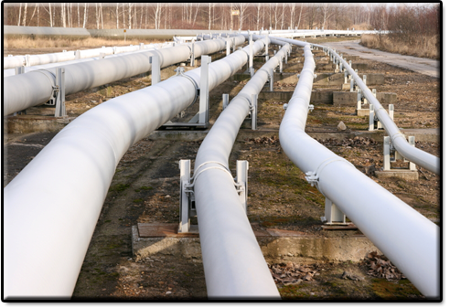
Table of Contents
Facts, Observations and Problems
Statement of Principles
Proposed Solutions

Slide 3
Facts, Observations and Problems

Slide 4
Facts
Since Order 636:
Virtually all contracts have been ratable flow contracts.
Ratable flow has meant 1/24th of nominated and scheduled daily quantity every hour.
There is some carry over No-Notice on Pipelines that have these services.
Comprises less than 15% of contracted transport service on Pipelines with No-Notice / Enhanced Services (i.e., non-1/24th hour services)
Comprises ~17 Bcfd of the ~230 Bcfd of Total US contracted Transport services
In essence, more frequent scheduling enables Shippers to achieve Intraday non-ratable flows versus the ratable flows that are associated with Day-Ahead scheduling
Primary to Primary is assured only when nominations are made, confirmed, and scheduled in the timely (Day-Ahead) nomination cycle.
This has been the GISB/NAESB/FERC Standard for the last 20+ Years.

Slide 5
Facts
Since Order 636:
Secondary can trump primary when primary has not been scheduled in the timely nomination cycle.
Flowing Interruptible can trump primary when primary has not been scheduled before the last Intraday nomination cycle.
With the exception of the California Energy Crisis, and absent force majeure, every shipper that has timely nominated and been confirmed; their Primary to Primary has been scheduled.

Slide 6
Facts
Vast majority of Gas-fired electric generation does not run at the same level of output every hour of the day.
Only 6% of Gas-fired Plants and 10% of Gas-fired output is from Plants that run at >80% load factor (Avg is 85%),
49% of Plants and 68% of output is from Plants that run at 40% to 80% Load-factors (Avg is 59%); and
45% of Plants and ~20% of output is from Plants that run at an average load factor of only 17%
(From EIA data for Plants that ran in the period Jan thru Nov 2015)

Slide 7
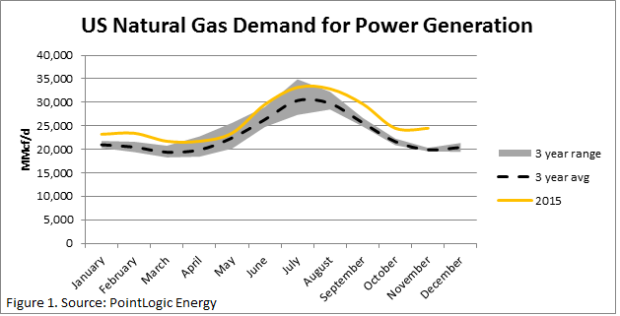
Observations
There is increasing demand for pipeline service provisions that would permit greater fuel delivery variability from ratable delivery – that is, after all, why we are here (i.e., to improve coordination by updating scheduling practices to enhance flexibility for power generation)
Generators want more intraday nomination cycles in order to achieve non-ratable takes vs. ratable per hour – i.e., 1/24th of timely (Day-Ahead) nominated
Pipelines provide non-ratable service right now under hourly tariffs and no-notice contracts

Slide 8
Observations
Outside of hourly tariffs and contracts, pipelines provide non-ratable service when capacity permits and does not threaten operations
Largely it is uncompensated use of line pack and line capacity that enables Pipelines to provide it
For the most part, when generators have gotten this non-ratable service, they have gotten it largely for “free”
Largely because it’s been “free” they want more of it – not only do they want more of it, they need non-ratable service to achieve reliability
And it seems more intraday cycles are seen as a way to get this service more often
There have been other periods when we have seen nearly infinite demand for “free”, or, under-market priced services in the past
1970’s gas shortages (Pre-price de-control)
1980’s First-Come-First-Served Interruptible (Order 436)
1990’s Monthly imbalance gaming before cash-outs (Order 436 and Early 636)
Notes:
What followed in each case?
Variable gas pricing by non-pipeline merchants;
Restructuring of Merchant as FT & Capacity release to compete with IT
Monthly and even daily cash-outs (i.e., during strained operating conditions)
In short, price formation and price signals changed behavior, brought discipline and led to new services.

Slide 9
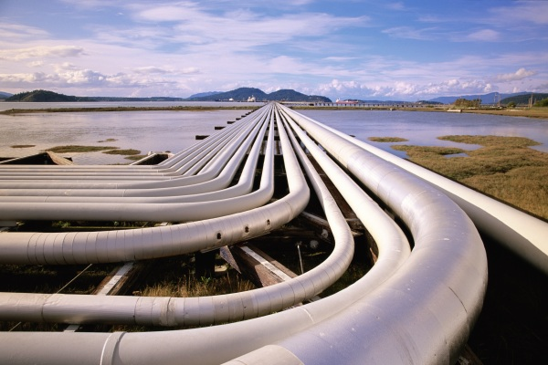
Problems
Pipelines are not compensated for non-ratable service
A free service cannot be relied upon
When service is free – even if unreliable – no one can compete with it nor can “priced” competitive alternatives be fashioned
Shippers cannot rely on their firm contracts unless they are nominated and scheduled for day-ahead firm
No way exists to “reserve” current contracted primary FT capacity for tomorrow

Slide 10
Statement of Principles:
Gas and electric wholesale markets should be economically and operationally coordinated so that products and services in each market can generate effective and actionable price signals in and across these two markets, and so that appropriate, right sized, investments are called forth in a timely manner.
Regulations and Standards, wherever possible, should be aimed at establishing self-correcting market structures that will further serve to support the generation of appropriate price signals that will incentivize market players to meet established policy goals.
Accurate and efficient price signals in both the gas and electric wholesale markets will determine the correct mix of investments.
As between: gas pipeline capacity, supplemental/alternative fuels, electric transmission capacity, demand response, energy efficiency, energy storage (gas or electric), and distributed energy resources, only correct price signals in the two markets will best direct capital and product/service investments.
Having “prices” for services has to start somewhere and more frequent scheduling with changes discussed below are a launching point for price formation.

Slide 11
Proposed Solutions

Slide 12
Allow Pipelines to Charge for Non-ratable Flows
Allow Pipelines to charge an hourly rate for non-ratable service
This charge could be one capped at the 100% load factor rate of their most recent incremental capacity addition’s recourse rate and would be charged for non-ratable flows which consume capacity outside of ratably scheduled under the scheduled contract

Slide 13
Non-ratable Flows
Require Pipelines to schedule non-ratable flows to the extent of available capacity provided the source(s) of supply and demand location(s), respectively, match such non-ratable flows on at least an hourly basis
Give Pipelines EFM access to supply and demand node(s) so flow matching can be verified
Once scheduled, these non-ratable flows will be secondary within-path priority for lesser of scheduled flow period or through the end of the Gas Day
Require pipelines to recognize within-day/ sub-day releases of capacity to be used by the acquiring shipper for scheduling non-ratable flows

Slide 14
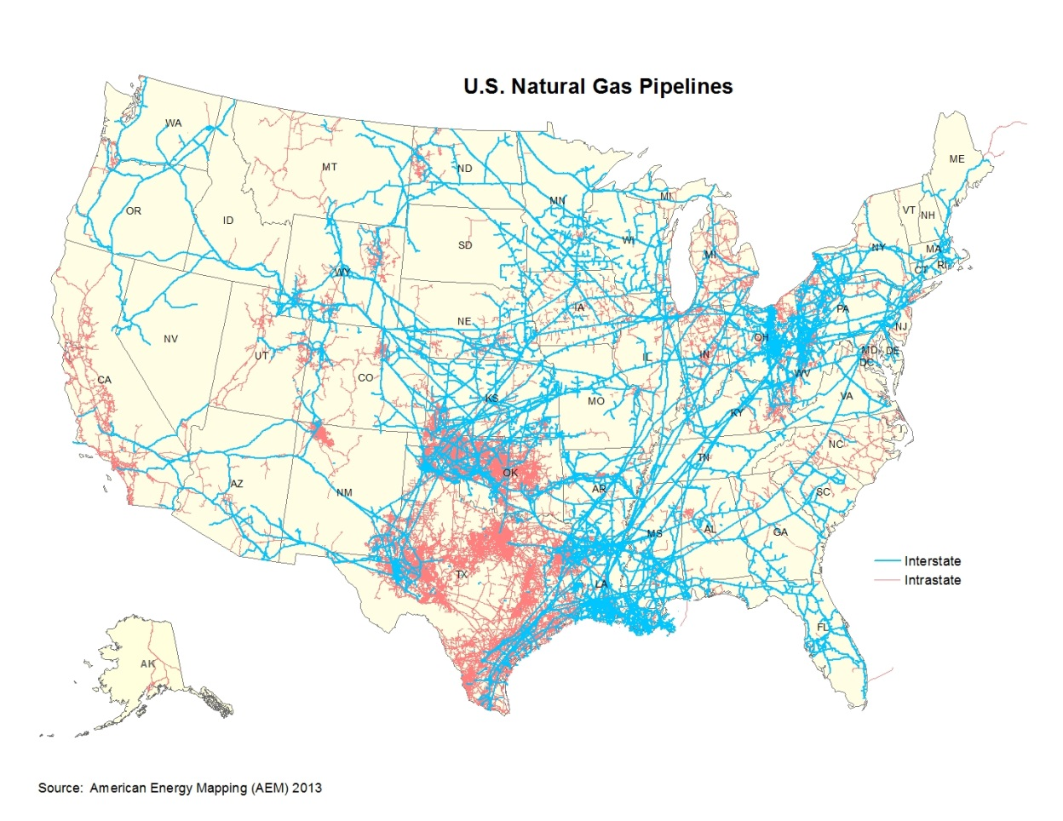
Pipeline to Pipeline
Permit the projection (to the extent operationally feasible) of pipeline-provided No-Notice service of a shipper on one pipeline to a shipper on an adjoining pipeline.
No tariff provision should inhibit third-party No-Notice service provided to a shipper on one pipeline from being projected to a shipper on an adjoining pipeline.
Both pipelines should have access to EFM related to the supply and demand nodes to verify flow matching.

Slide 15
Pipeline Provisions
Pipelines with at least 500 MW of connected natural gas fired generation should provide at least 14 nomination cycles per day
2 for day ahead (Timely and Evening)
12 for within gas day (intra-day)
All pipelines should provide at least 2 biddable Capacity Release cycles per day
1 in advance of timely
1 for within day
All pipelines should provide for at least hourly non-biddable capacity releases to support the providing of non-ratable flows
Notes:
All pipelines should provide for at least hourly non-biddable capacity releases to enable shippers with un-used hourly capacity to release that capacity to another firm shipper desiring non-ratable flows so that there is competition in the market for capacity able to support the providing of non-ratable flows.
This enables shippers with un-nominated capacity to sell short-term blocks of capacity to replacement shipper(s) desiring additional hourly capacity in support of non-ratable flows.

Slide 16
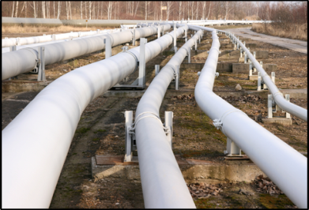
Reserving and Bumping
Pipelines should permit FT shippers to make a “Flow Day Reserved Capacity” nomination and have it scheduled (regardless of actual flow) provided Shipper pays an additional variable charge for such reservation - suggested charge – TBD – could be IT rate for nominated but not-flowed capacity.
Pipelines should permit bumping by Primary and Secondary within-path FT of scheduled IT and secondary out of path FT provided the bumping shipper agrees to pay to the pipeline an additional variable charge for such bump – suggested charge – TBD – could be IT rate for the bumped quantity.

Slide 17
Why make these changes?
It’s all about Price Signals
Scheduling practices and service offerings both can both create (i.e., “effect”) and affect price signals
Without price signals and price formation none can determine what the real supply or compensable value electric gen focused pipeline provided services might be.
While there can be infinite demand for free or underpriced goods; if there is no price you can’t buy them when you want them.
Let’s formulate a pricing and service experiment and take it from there.

