Slide 1
NAESB Confirmations Opportunities for Improvement
Sylvia munson
Consultant for FIS

Slide 2
Introduction
Sylvia Munson
FIS (Formerly SunGard)
Providing ideas at a high level / concept level with a handout available containing more detail

Slide 3
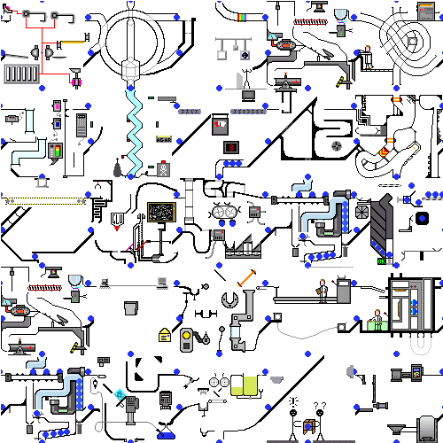
Nominations
Scheduled Quantities
Confirmations

Slide 4
Accept Best-Efforts nominations
Accept and Confirm Best-Efforts nominations on an Intra-cycle basis
Ability to submit a nomination between cycles and have it processed and flowing within one (1) hour
Accept nominations at any time in the gas day until a specified end time
True-up these nominations with standard intra-day nominations at the existing intra-day timelines
Best-efforts nominations cannot bump existing flow

Slide 5
Have one consistent set of data for confirmations
Confirm all nominations at the Shipper – to – Shipper level
Have a single level of confirmations for all locations
Consistent practices
Most control and expected results for shippers

Slide 6
Fine tune the confirmations + scheduling window
How many iterations of confirmations are needed within each scheduling cycle?
At exactly what time are confirmation requests issued and confirmation responses required?
Create a defined timeline with deadlines within the existing window to encourage consistent responses and experiences

Slide 7
Remove the unsolicited confirmation option
Current Confirmation datasets and standards permit the confirmation response to contain new information that was not in the original request.
When a confirming party provides new information, it requires manual intervention
Data that does not match should follow the confirmation cut rules
Eliminate the ability to provide new, additional information in the confirmation response

Slide 8
Standardize the confirmations practice for best efforts nominations
If we add a standard Best-Efforts nomination process then it should include a corresponding confirmations process so that we can have consistent and efficient results

Slide 9
Create a standard list of best-practice confirmation methods / options
There are a small number of confirmation methods identified in NAESB standards
There are a lot more confirmation methods that are in practice but are not standardized
Pre-arranged confirmation
Automated confirmation (no confirmation required)
No confirmation required if transaction is for fewer than N days
These confirmation options need standardization so that they create a consistent pick-list during contract negotiations

Slide 10
Upgrade confirmations datasets to xml
We tested XML in 2001 and found it to be ‘not ready for prime time’
Today, it has evolved, matured, expanded
And, we’re already using it for FERC interaction
It’s time to look again at moving NAESB datasets to XML
The Confirmations datasets would be a good set to model as a starting point and it would gain needed efficiencies in the confirmations process.

Slide 11
Please make sure you get a copy of the Handout
Thank you!
Sylvia Munson
sylvia@contentsunderpressurebook.com

