Slide 1
NAESB GEH Forum Dan Buckner Director of Fuels Origination and Strategic Development

Slide 2
Who is ACES
ACES is a Nationwide Energy Management Company
We Help Our Clients Buy, Sell, and Manage Energy More Efficiently, With Less Risk

Slide 3
ACES Today
Portfolio Management Overview
Manage Resources in PJM, MISO, SPP, CAISO, ERCOT
50,000 MW of Generation From 300 Plants
50,000 MW of Load
3.0 Bcf/Day Peak Natural Gas
Active on 30 Natural Gas Pipelines
Four Regional Trading Centers:
Indiana, Minnesota, North Carolina, & Arizona

Slide 4
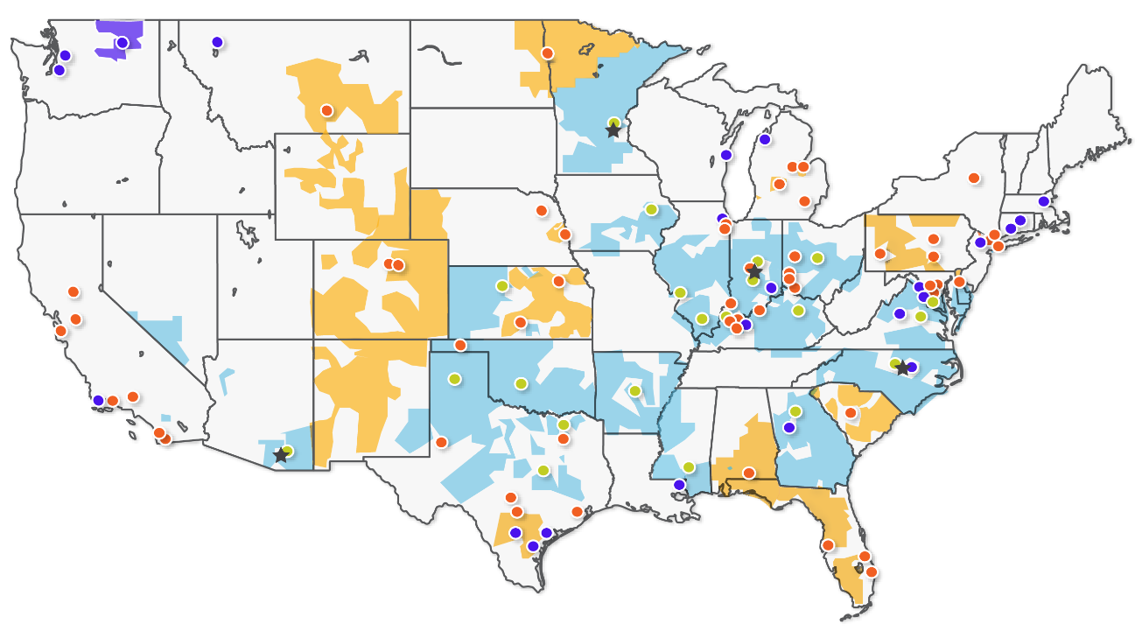

ACES Today
RTC
Customers
Members
Inactive Customers
Customer Load
Member Load
Inactive Customer Load

Slide 5
Review: FERC Activity
March 2014: FERC Issues NOPR
“To Better Coordinate the Scheduling of Natural Gas and Electricity Markets in Light of Increased Reliance on Natural Gas For Electric Generation”
April 2015: FERC Issues Final Rule
Later Deadline For Timely Nomination Cycle
Adds 1 Additional Intraday Nomination Cycle
No Change to the Gas Day Start Time (10 a.m. EPT)
ISOs/RTOs Required to Align Their DA and RAC/RUC Unit Commitment Schedules in Advance of the Timely and Evening Cycles; or Show Cause
Source: FERC Gas Day Final Rule (Order No. 809)

Slide 6
Natural Gas Timeline Changes
Natural Gas Scheduling Timeline (EPT) |  | Current Times | Revised Times
Timely Nomination Cycle | Deadline | 12:30 p.m. | 2:00 p.m.
 | Gas Flow Begins | 10:00 a.m. | 10:00 a.m.
Evening Nomination Cycle | Deadline | 7:00 p.m. | 7:00 p.m.
 | Gas Flow Begins | 10:00 a.m. | 10:00 a.m.
Intraday 1 Nomination Cycle | Deadline | 11:00 a.m. | 11:00 a.m.
 | Gas Flow Begins | 6:00 p.m. | 3:00 p.m.
 | IT Bump Rights | Yes | Yes
Intraday 2 Nomination Cycle | Deadline | 6:00 p.m. | 3:30 p.m.
 | Gas Flow Begins | 10:00 p.m. | 7:00 p.m.
 | IT Bump Rights | No | Yes
Intraday 3 Nomination Cycle | Deadline |  | 8:00 p.m.
 | Gas Flow Begins |  | 11:00 p.m.
 | IT Bump Rights |  | No
Source: FERC Gas Day Final Rule (Order No. 809)

Slide 7
Day-Ahead Timelines
RTO | Effective Date* | Old DA Submittal | New DA Submittal | Old DA Results | New DA Results
PJM | 3/31/16 | 12:00 p.m. EPT | 10:30 a.m. EPT | 4:00 p.m. EPT | 1:30 p.m. EPT
MISO | 11/5/16* | 11:00 a.m. EST | 10:30 a.m. EPT | 3:00 p.m. EST | 1:30 p.m. EPT
SPP | 10/1/16* | 12:00 p.m. EPT | 10:30 a.m. EPT | 5:00 p.m. EPT | 3:00 p.m. EPT
Processing Times For DA Energy Markets Are Different Across Markets, Driving the Different Timelines
Effective Date Refers to DA Timeline Changes
Not Electric Operating Day
FERC Has Yet to Rule on MISO’s Proposed Effective Date
SPP May Need to Clarify With FERC Regarding the Effective Date

Slide 8
PJM (All Times EPT)
RTO | Effective Date | Gas Trading | DA Bids | DA Awards | Timely Cycle
PJM | 3/31/16 | 8:00 – 10:00 a.m.* | 10:30 a.m. | 1:30 p.m.* | 2:00 p.m.
Will Gas Markets Change?
Tight Execution Window
Services, Trading Window, Etc.
Purchase Gas For DA Award in Timely Cycle?
Peak Days - May Help With Priority on Pipeline?
DA Award is Not Necessarily an RT Dispatch, Could Impact Strategy
RTO | Rebid Period | RAC Results | Nomination Cycle
PJM | 1:30 – 2:15 p.m. (Opening as Early as Awards Post) | 3:00 p.m. For Morning Ramp CTs | 3:30 p.m. (ID2)
 |  | 6:30 p.m. For Other Plants | 7:00 p.m. (Evening)
RAC Dispatch in PJM is Treated as a RT Dispatch
Designed to Allow For Gas Purchases During Evening Cycle
Definitive Start Time, But Not Definitive Gas Volumes
Tight Execution Window and Market Illiquidity

Slide 9
Scheduling Request
Why Are We Here?
We request that gas and electric industries, through NAESB, explore the potential for faster, computerized scheduling when shippers and confirming parties all submit electronic nominations and confirmations, including a streamlined confirmation process, if necessary.
Coordination/Timing Challenges Still Exist
Would a Quicker Nominations Process be an Improvement?

Slide 10
Coordination Challenges

Slide 11
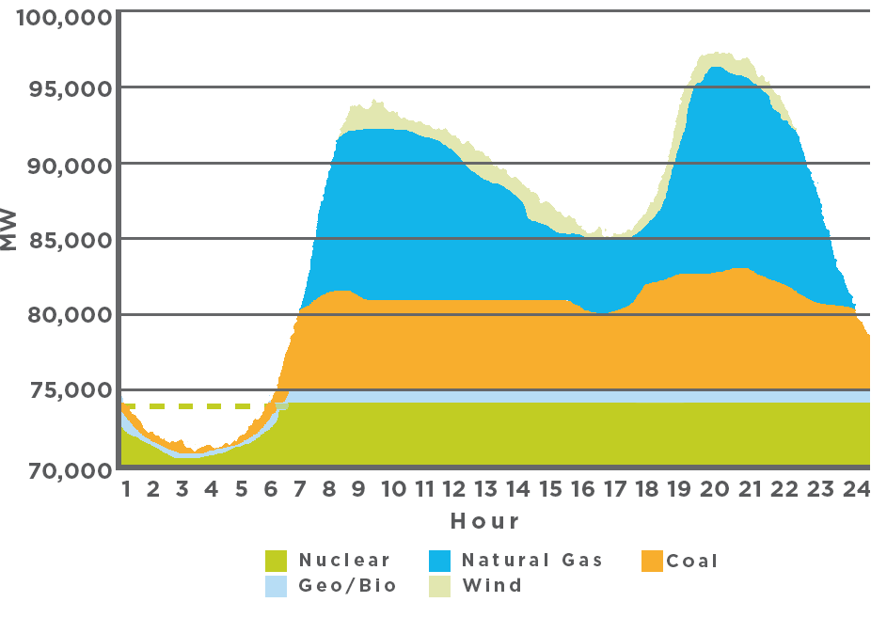
Generation Profile Challenge
Source: ACES

Slide 12
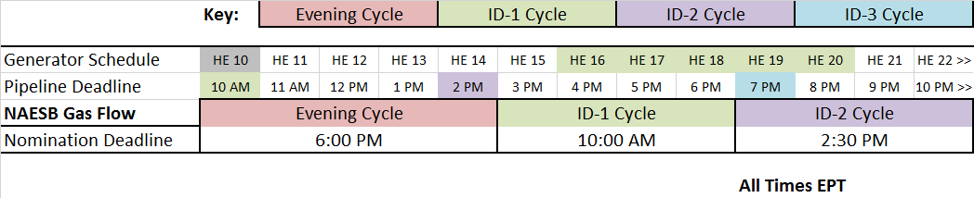
Timing Challenges
Source: ACES
Generator Schedule Does not Match Gas Cycle
Generator Schedule Provided After Nomination Cycle Deadline
Can Quicker Electronic Scheduling Improve Coordination Between These Markets?

Slide 13
Generator Requirements
Generator Needs | Firm Transportation Service
Quick Start Up Capability | Not a Firm Right
Non-Uniform Hourly Consumption | Not a Firm Right
Pressure Requirements | Sometimes Included
After Hours Consumption Change Capability | Not a Firm Right
Even Shippers With FT Depend on Interruptible Operational Flexibility From the Pipelines to Manage Key Operational Requirements

Slide 14
Generator Requirements
Generator Needs | Firm No-Notice Services
Quick Start Up Capability | Firm
Non-Uniform Hourly Consumption | Typically Allowed
Pressure Requirements | Sometimes Included
After Hours Consumption Change Capability | Firm
Unfortunately, Pipelines Have a Limited Amount of No-Notice Services Available

Slide 15
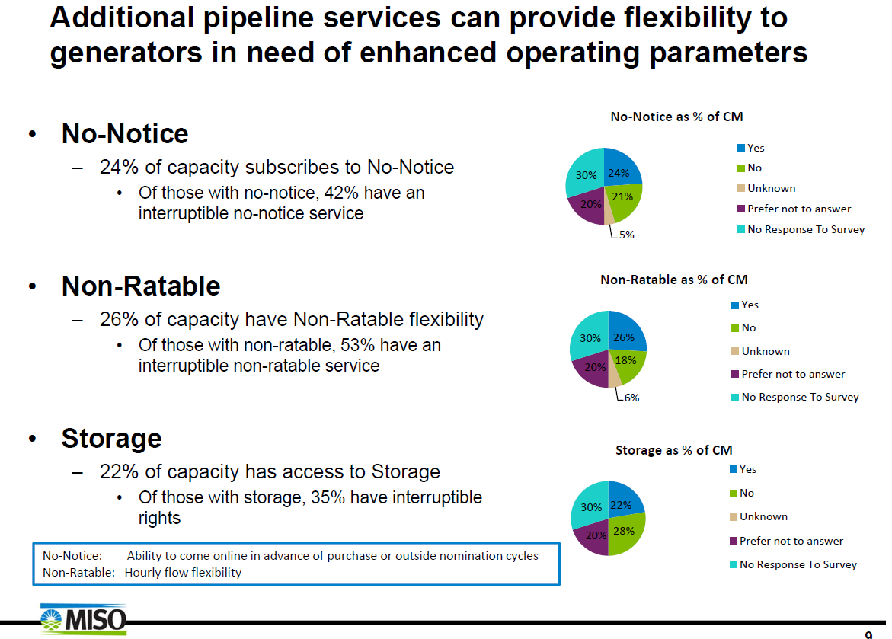
Interruptible Services
MISO Winter Generator Fuel Survey (Dec 2015)
13% of Generators Relied on FT Only
Source: MISO

Slide 16
Interruptible Services
PJM Gas-Fired Generation (2014 EIPC Study)
60% Do Not Have FT or Dual Fuel (Rely on IT)
25% Have Dual Fuel
15% Have FT
PJM’s Capacity Performance
Provides Some Recovery of Pipeline Costs
$ Amount Determined by Auction
Cleared 1 Year at a Time – Pipeline Expansion Projects Require Multiyear Service Agreements/Cost Recovery

Slide 17
Interruptible Flexibility
Power Generators Rely on This Interruptible Operational Flexibility
For Quick Starts
For Non-Uniform Hourly Consumption
To Allow for Changes After Hours
On Many Pipelines, These Services Have Been Highly Reliable
Forcing Pipelines to Process Quicker May Result in Decreased Operational Flexibility

Slide 18
Impacts of Quicker Scheduling
Quicker Scheduling MIGHT Provide Increased Operational Flexibility
Better Coordination with Dispatch Timing
Quicker Scheduling MIGHT Reduce Operational Flexibility
Less Time to Determine if Interruptible Operational Flexibility is Available
Limited Firm Services Available to Provide the Required Operational Flexibility
Electric Generators Cannot Lose This Operational Flexibility

Slide 19
Summary
Coordination/Timing Challenges Remain
Generators Rely on Interruptible Services
Firm Transportation Does not Provide Sufficient Operational Flexibility
No-Notice Services are Limited and Expensive
Gaining Quicker Electronic Coordination, But Losing the Interruptible Operational Flexibility Would Impact Reliability
Proceed with Caution

