Slide 1
Explanation of NAESB Request R11012
October 13, 2011
Kathryn Burch, Project Manager - Standards and Regulatory Compliance
Michael Wolf, Senior Commercial Business Analyst

Slide 2
Dynamically Linked Activities
Dynamically Linked Activities is an enhancement designed to streamline the process of creating Linked Activities within the LINK® System and allow users more flexibility when entering their nominations.
Characteristics of Dynamically Linked Activities
  Four new columns have been added to the Grid in the Nomination screen:
    Upstream Activity Code (Up Act Cd),
    Upstream Transaction Type (Up TT),
    Downstream Activity Code (Dn Act Cd), and
    Downstream Transaction Type (Dn TT).
  Linkages can be created/edited for a single day or date range.
  Online and batch validations will continue to be applied as they have been.
  When one Linked Activity is nominated, the system will automatically nominate the corresponding Linked Activity(ies) on downstream contracts and gross up/down for fuel accordingly.
  Any change in quantity on one activity will be propagated throughout the linkage to ensure all quantities match.

Slide 3
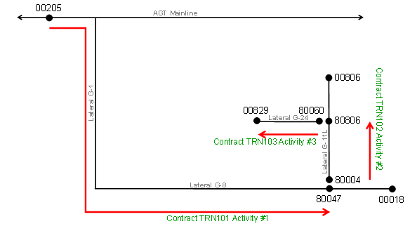
Dynamically Linked Activities
– How it works
By linking activities, customers will be able to conduct their business more efficiently within the LINK® System. Previously, customers nominating down laterals on Algonquin would have to enter multiple nominations (like those shown below) in the LINK® System and would have to track any reductions and re-nominate accordingly.
Our functionality will allow customers to enter one nomination which will then be propagated to other pre-defined activities selected by a customer. Additionally, an increase/reduction to any activity that is linked will be propagated to all other activities in the linkage.

Slide 4
Dynamically Linked Activities
– How it works
The example on the previous slide can be used to show how the new columns being requested can aid customers in entering their nominations. In the LINK® System, customers have to set up three activities on three separate contracts in order to nominate from Mendon on the Algonquin mainline down the Canal Lateral and ultimately to a point on the Cape Cod Lateral. Currently, customers have to enter into each of these contracts and enter nominations in order to achieve the end result desired.
Using the three activities customers have previously set up, a customer can now fill in the Up Act Cd/Up TT and/or Dn Act Cd/Dn TT (depending on the linkage being created) in order to have nominations automatically created. In the examples below, once the activities have been linked (by entering the Up/Dn data), a Requested Quantity entered on any activity will be propagated to the other two activities without ever having to edit the other contracts. I.e. when a customer nominates activity 000001 on TRN101, the LINK® System will automatically enter nominations on contracts TRN102 and TRN103 (activities 000002 and 000003, respectively).
“Upstream” activity
“Midstream” activity
“Downstream” activity

Slide 5
Dynamically Linked Activities
For any additional questions about this enhancement,
please contact:
Michael Wolf
Office: (713) 627-5574
MAWolf@spectraenergy.com
Kathryn Burch
Office: (713) 627-5765
KLBurch@spectraenergy.com

