Slide 1
Two-Tier Firm Curtailment
Support
WEQ Executive Committee Meeting
August 16, 2011

Slide 2
Where we are today
On February 17, 2011 – The subcommittee passed a motion to seek further guidance on whether two-tier firm curtailments with the expectation that the guidance would go all the way to FERC. The two camps both felt they would prevail at FERC.
On March 8, 2011 – The subcommittee put a hold on seeking guidance pending a decision whether they wanted to include two-tier firm curtailment in the options
During March and April the subcommittee identified key concepts that needed to be resolved/included in the two options for Parallel Flow Visualization, in order to select an option to move forward.
On April 28 by a balance vote of 7.66 to 2.34 the motion passed to include two-tier firm curtailment in the two options before the subcommittee could select an option to move forward.

Slide 3
Framing the Issue
The issue is:
  Whether the two-tier firm curtailment concept conflicts with current FERC policy? Prior to seeking FERC staff guidance, a policy issue needs review by the Board/Managing Committee to decide either it does not conflict with FERC policy and the two-tier firm curtailment concept can be included in the Parallel Flow Visualization Permanent Solution or the white paper and position papers will be forwarded to FERC staff for their input
The issue is not:
  Whether the Executive Committee members support/oppose two-tier firm curtailment
  To validate/invalidate the concept based on the approach being designed by the subcommittee to implement the concept

Slide 4
Policy Concerns Focus
Violates NAESB Bylaws
Sets Policy
Conflicts with FERC Policy

Slide 5
Bylaws Section 2.2
120 Develop Practices, Not Policy – The committees, subcommittees and task forces
121 of NAESB should endeavor not to create policy in their Standards or Model
122 Business Practices development activities absent being requested to do so by the
123 Board.
124 Incorporate Best Practices – To the extent reasonable, the Standards and Model
125 Business Practices to be established should reflect standardization and
126 streamlining of activities chosen as best practices from among existing and
127 reasonably anticipated policies and practices. (emphasis added)
The group supporting this two-tier firm curtailment believe the concept passes the Incorporate Best Practices test in the bylaws.

Slide 6
Pro-forma OATT
13.6 Curtailment of Firm Transmission Service:
In the event that a Curtailment on the Transmission Provider's Transmission System, or a portion thereof, is required to maintain reliable operation of such system and the system directly and indirectly interconnected with Transmission Provider’s Transmission System, Curtailments will be made on a non-discriminatory basis to the transaction(s) that effectively relieve the constraint. Transmission Provider may elect to implement such Curtailments pursuant to the Transmission Loading Relief procedures specified in Attachment J. (emphasis added)

Slide 7
Pro forma OATT Attachment J
(Name of Transmission Provider) Open Access Transmission Tariff
Original Sheet No. 165
ATTACHMENT J
Procedures for Addressing Parallel Flows
To be filed by the Transmission Provider
(Leaves the door open for NAESB to develop standards for addressing parallel flows)

Slide 8
FERC Order WECC Unscheduled Flows
UNITED STATES OF AMERICA
FEDERAL ENERGY REGULATORY COMMISSION
18 CFR Part 40
[Docket No. RM09-19-000; Order No. 746]
Western Electric Coordinating Council
Qualified Transfer Path Unscheduled Flow Relief Regional Reliability Standard
(Issued March 17, 2011)

Slide 9
FERC Order WECC Unscheduled Flows
SUMMARY: Under section 215 of the Federal Power Act, the Commission approves regional Reliability Standard of the Western Electricity Coordinating Council (WECC) IRO-006-WECC-1 (Qualified Transfer Path Unscheduled Flow Relief) and six associated new definitions submitted to the Commission for approval by the North American Electric Reliability Corporation. This Reliability Standard is intended to mitigate transmission overloads due to unscheduled flow on a transfer path designated by WECC as being qualified for unscheduled flow mitigation. (emphasis added)

Slide 10
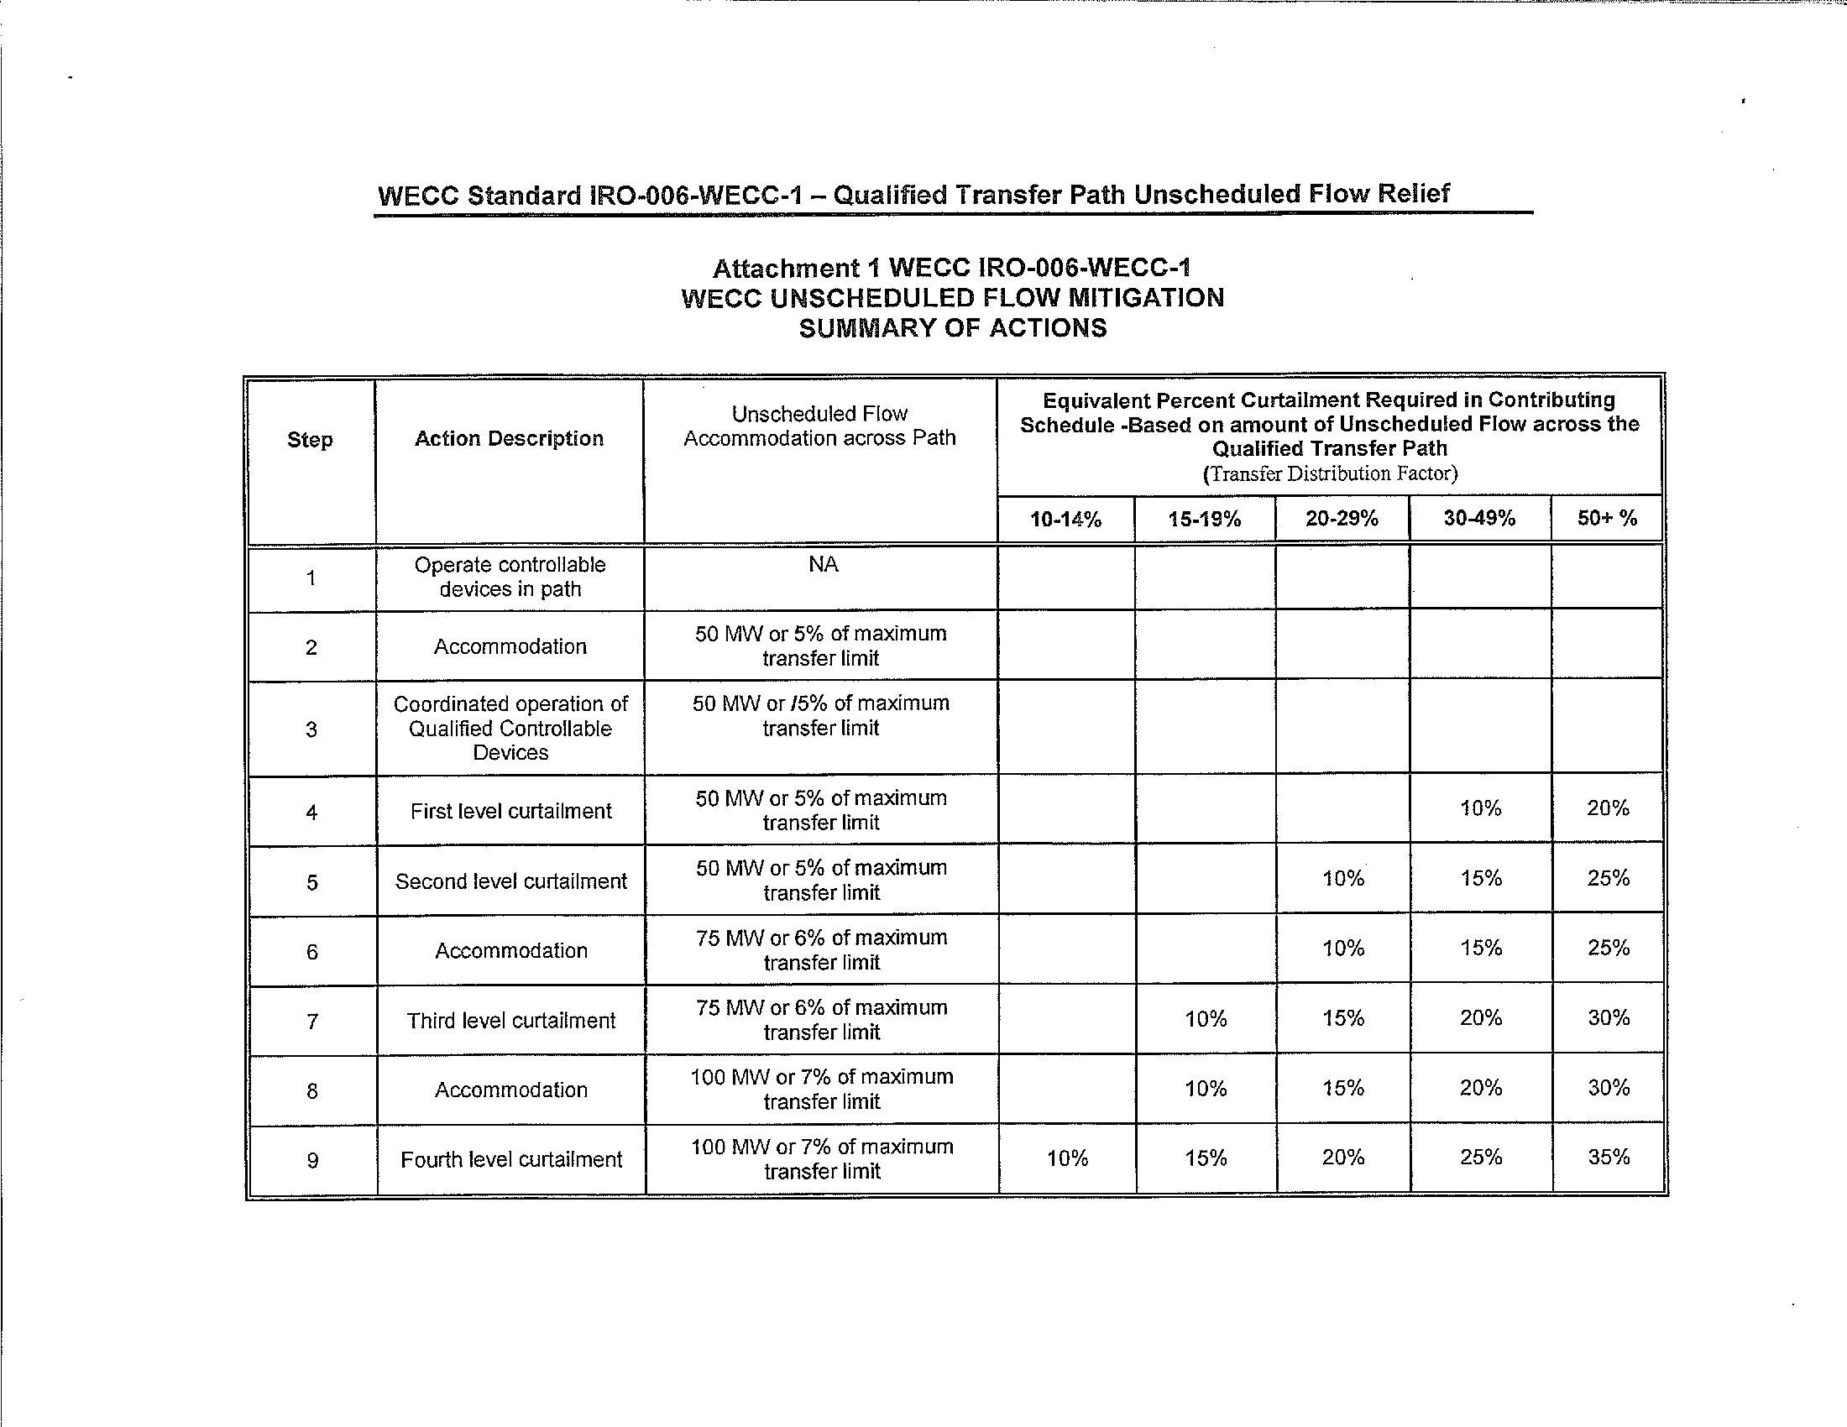
FERC Order WECC Unscheduled Flows
FERC Order approved curtailing unscheduled flows prior to curtailing scheduled flows pre Order 888 but reaffirmed this year. In this process curtailing unscheduled flows does not occur until step 4. Under the two-tier firm curtailment proposed for the Eastern Interconnection curtailing unscheduled flows would not occur until TLR Level 5

Slide 11
Seams Agreement vs Coordination Agreement
Policy Concern uses FERC reference of addressing Seams Coordination on case-by-case basis.
  The subcommittee agreed to change the term Seams Agreement to Coordination Agreement. Mr. Sander stated that the term Seams Agreement has a much broader connotation than what was the scope of an agreement for the Parallel Flow Visualization Agreement. (June 14-15 WEQ BPS Meeting)
Coordination Agreements are required
  The subcommittee considered requiring all parties to enter into coordination agreements
  The subcommittee elected to make Coordination Agreements optional
  This is a best practices concept for granting firm transmission service
    If you consider the impact on my flowgates when granting service when that service is contributing to congestion on my flowgate, the service will go into last-to-curtail
    If you don’t consider the impact on my flowgates when granting service when that service is contributing to congestion on my flowgate, the service will go into first-to-curtail

Slide 12
Summary Two-Tier Curtailment
The concept does not violate NAESB Bylaws
  Directly aligns with the section of “incorporating best practices”
The concept does not set new policy or conflicts with FERC Policy
  Order 746 which was issued four years after Order 890 reaffirmed that under certain circumstance unscheduled flows could be curtailed prior to scheduled flows
  Order 890 FERC left it up to the industry on how it wanted to deal with parallel flows (unscheduled flows)
The subcommittee voted by a significant margin to include two-tier firm curtailment in the option to move forward
The subcommittee should be directed to continue moving forward on standards development based on the decisions it has made

