Slide 1

NAESB BPS Sub-team (Action Item 72)
Bert Bressers 12/08/2011

Slide 2
NAESB BPS Sub-team (Action Item 72)
SCOPE DEFINITION
A sub-team will conduct a table top analysis of the two impact calculations that are currently included in IDC Change Order 283 and make a recommendation to the subcommittee on whether we should begin the Parallel test with one of the calculations or both calculations after applying some suggested modification proposed by OATI.
After reviewing the initial data the sub-team will provide a timeframe on when they can complete their work.

Slide 3
NAESB BPS Sub-team Action Item 72
Members Sub-team
Bert Bressers
Nelson Muller
Steve Sanders
Shah Hossain
Blaine Erhardt
Krithika Shenoy
Frank Koza

Slide 4
Related parking Lot Item 5
(Steve Sanders)
IDC Generation-to-Load (GTL) Impact Calculation Requirements
The current design of the IDC PFV tool includes the ability to perform the GTL impact calculation with two methods:
  1) GLDF within BAA and
  2) native/transfer for markets/BAAs with multiple Local Balancing Authorities (LBAs).
Two methods were included because they are both utilized for the current congestion management process (for non-markets versus markets with CMP) and may be needed depending upon the requirements of the Permanent Solution.
The IDC impact results between the standard GTL GLDF and native/transfer calculation will be different based upon current IDC directional (forward and reverse) calculations. Therefore, a party’s curtailment responsibilities will be different based upon the calculation method used for each of the parties that impact the Flowgate in TLR. Until the requirements of the Permanent Solution are finalized, the future need for the native/transfer calculation is unclear. Depending upon the final design of the Permanent Solution, two different impact calculation methods could create non-comparable treatment between parties.
Therefore, once the Permanent Solution requirements are finalized following the parallel testing, the BPS will review the need for two impact calculation methods to ensure that all parties are treated comparably by the IDC impact calculation. If there is a need for two impact calculation methods, the NAESB standard will outline the requirements to utilize each calculation method.

Slide 5
Related Action Item 73 BPS
Tom Mallinger and Ed Skiba had Action Item 73 (though Tom did all the work) to provide the sub-team working on Action Item 72 with available documentation that was used to move to two impact calculations. Tom found three documents which have been posted as work papers for the December BPS meeting.
The links for the documents are listed below:
  Action Item 73 - IDC Change Order 114
  Action Item 73 - ORS Feb 9-10 2005 minutes (see section on Accuracy of MISO and PJM Next-Hour Market Flow Calculation)
  Action Item 73 - ORS Presentation IDC Change Order 114 February 2005

Slide 6
NAESB BPS Sub-team (Action Item 72)
Example

Slide 7
Example demonstrating issue
Next slide explains the differences for the Forward impact calculation of PFV using either the Market approach (GTL + transfer) or the Non-Market approach (GTL only).
  Market approach: Forward impact 700 MW
  Non Market approach: Forward impact 1600 MW
Note: The generation and load data on the next slide is fictive.
The results listed above and listed on the next slide present an actual calculation
for a particular SPP flow gate for SPP Market footprint.

Slide 8
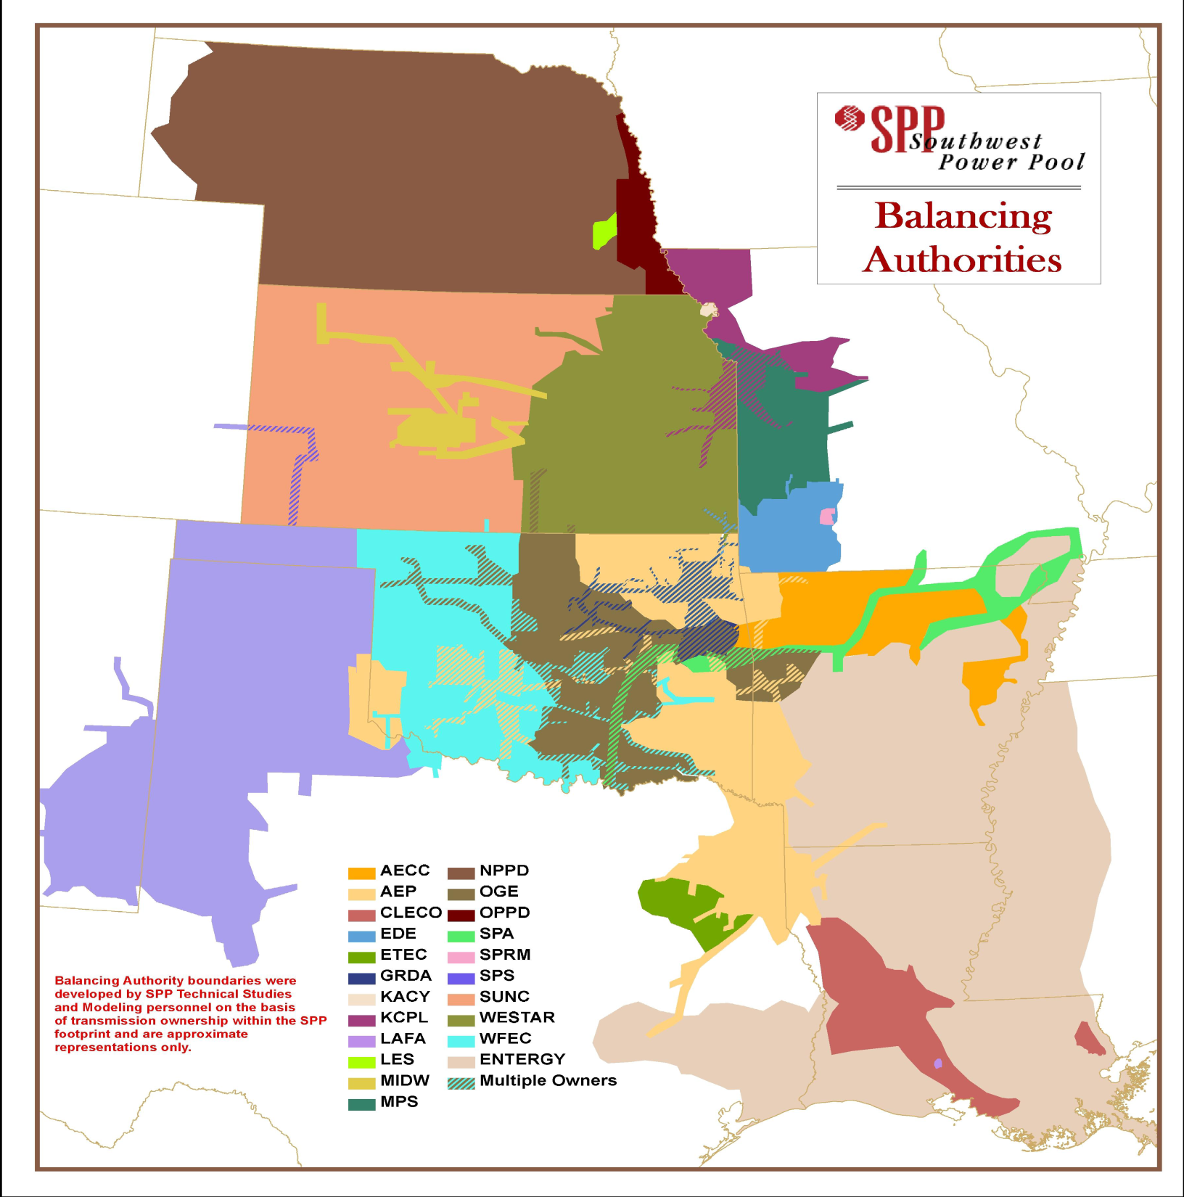
SPP EIS Market
BA’s 2011.
Generation: 1500
Load: 1000
NPPD
OPPD
LES
Transaction considered by
PFV Gen-to-Load Calculation
* Market approach: 500 MW
* Non Market approach: 1500 MW
KACY
INDN
XXX
SPP EIS Market BAs (16)
SECI
WR
KCPL
MPS
SPRM
EDE
Flow gate
WFEC
GRDA
OKGE
SPS
Represents
weighted average
Load Shift factor
SPP EIS Market
CSWS
Applied calculation PFV | Forward impact | Reverse impact | Net Impact
 | MW | MW | MW
Market approach | 700 | 300 | 400
Non Market approach | 1600 | 1200 | 400
Represents
transaction
that is included
in the impact
calculations of
Market Flow
Used for relief
8

Slide 9
NAESB BPS Sub team (Action Item 72)
Summary
discussions

Slide 10
Summary discussions
Don’t remove transfer logic
1
Applying the Gen-to-Load calculation without the transfer logic to a Market and Non Market footprint results in over-reporting Forward impacts of the Gen-to-load of Markets and Non Markets and would result in a higher relief obligation that doesn’t represent the true contribution of the Market or Non Market to the loading of the constraint flow gate.
No support within the sub-team to consider removing the transfer logic from the CO 283.

Slide 11
Summary discussions
Apply transfer logic also to Non-Markets
2
A large footprint should be split up in sub-areas in the PFV calculations regardless of the type of Entity (Market, Non-Market) and only the net transfer flow between the sub areas should be included in the Forward PFV impact calculations. (added to the Forward and Reverse impact of the Gen-to-Load of the individual sub-areas)
Nelson mentioned in the 12/9/2011 Call that the current CO283 functionality is able to calculate the Gen-to-Load impact of Non-Market areas with the same transfer logic as used for Market areas. It will require some changes to the IDC Model and some additional data submission by the Non-Market Entity. According to Nelson no software changes needed to CO283 logic to make this work, only model changes and some additional data submission.
Sub-team members agreed that there need to be some more discussion about how granular the transmission system can (and should) be modeled in IDC for applying the transfer logic. This is referring to the rules that may need to be developed on the use of load zones by parties to obtain a native and transfer component in order to reduce one’s calculated forward impact to make it more accurately represent the true contribution to the loading of a constraint.

Slide 12
Summary discussions
The Sub-team agreed in the 12/9/2011 call with full consensus to continue its work in following areas:
3
Discuss guidelines for defining how granular the transmission system could (and should) be modeled in IDC for applying the transfer logic.
Review the OATI proposal to possible apply a new methodology for the Gen-to-Load calculation. Proposal send out by Nelson Muller on 12/9/2011 to Sub-team.
The Sub-team wants to see some scenarios run on selected flowgates for OATI’s methodology, in addition to the present calculations and an approach based on netting Gen-to-Load impacts instead of calculating forward and reverse impacts.
If the Sub-team at some time in the future after understanding the OATI proposal and analyzing results believes the OATI methodology should be seriously considered for PFV a recommendation will be made to the BPS.

